Slide 1
AT&T Fleet Complete Asset Tracker (AT1)
Month Date, 2021

Slide 2
Agenda:
Evaluating Your Assets
Cost of underperforming Assets
Cost of lost or Stolen Assets
Versatile Industry Solutions
Things to consider
Flexible applications
Features and benefits
Products
AT1 Wired
AT1 Solar
Comparison

Slide 3
Features and Benefits
Installation in seconds
Using double-sided tape or screws device is quick to install on any asset
Integrated Sensors
Humidity, light, and temperature sensors
AT&T
Asset Tracking
Small Size
One of smallest tracking devices in market
End to End System
Device, cloud IT, applications, security, connectivity and customer support
Low-cost Solution
Bundle with FC software and data plan for $10/month

Slide 4
Features and Benefits
Full insight into unauthorized usage – on and off jobsite
Alerts for any detected movement outside the predefined perimeter around a job or a storage site, signaling potential theft.
Reduce the time spent on end-of-day inventory check
Reports on daily position and status changes of valuable assets eliminate the need to physically inspect every jobsite and verify that all assets are where they are supposed to be.
Extensive battery life
The AT1 device runs on the latest low-power LTE-M network, designed to consume a fraction of the power used by other batteries.
The AT1 Solar uses a solar panel to recharge its battery when exposed to direct sunlight for at least 5 hours.
Cargo integrity
status alerts
Get alerted to any unwanted container door activity or variations in ambient temperature, humidity or light within the container as soon as it happens and notify the appropriate channels.

Slide 5
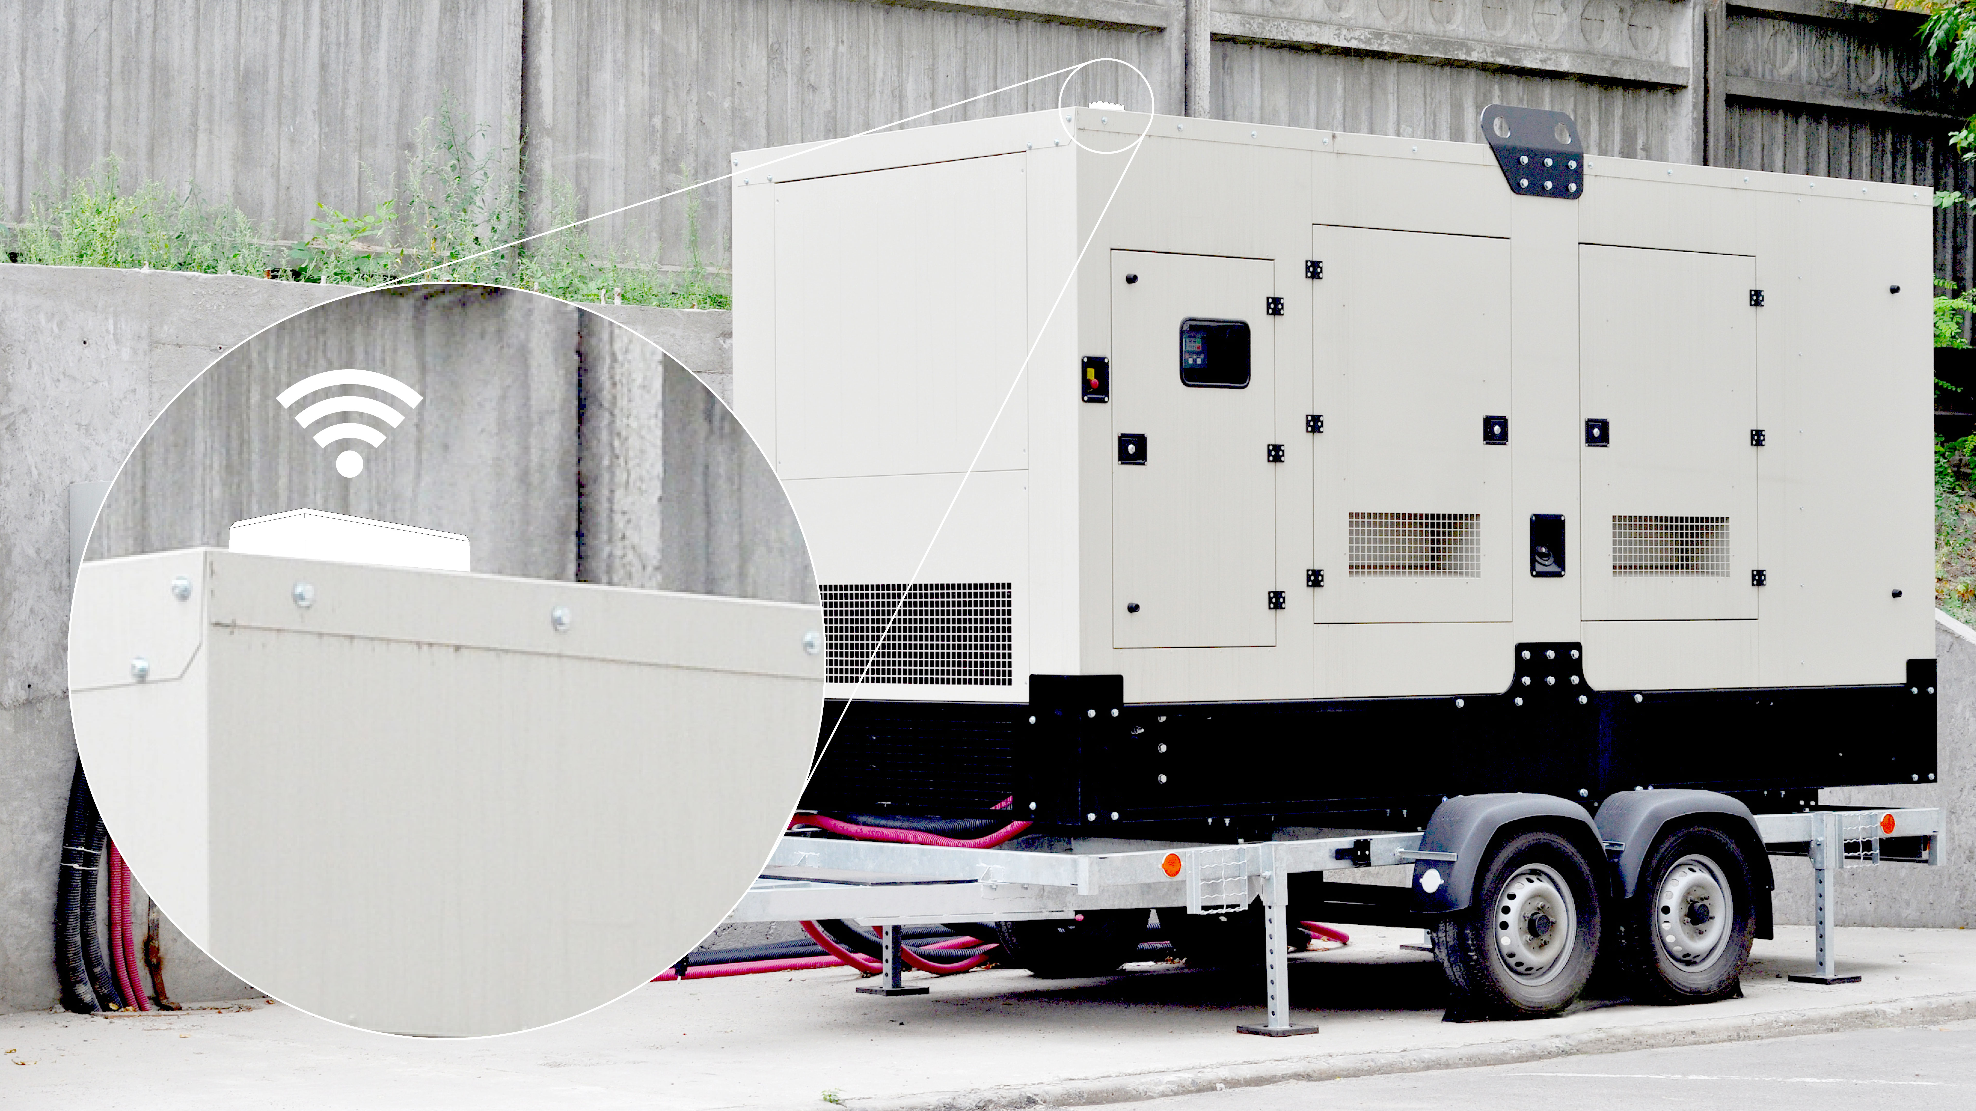
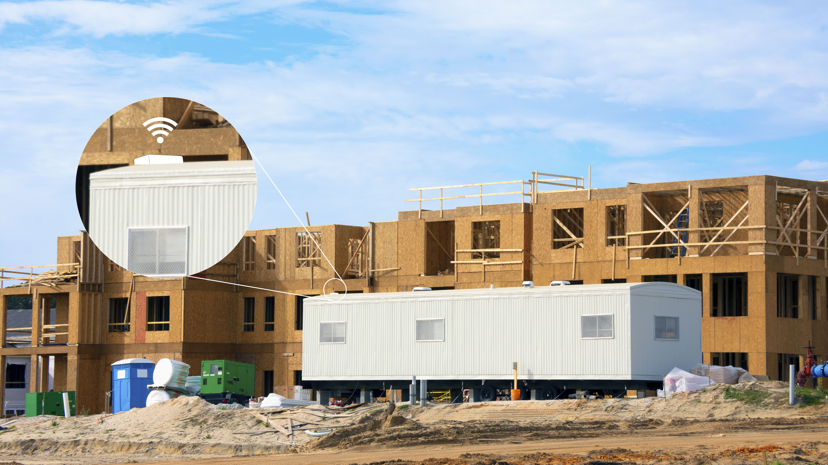
Innovative solutions for diverse business needs
Transportation
ABM/Vending Machine
Distribution
Public Safety
Heavy Duty Equipment
Agriculture
High-value Inventory
Trade Services

Slide 6
Evaluating Your Assets

Slide 7
Cost of Underperforming Assets
How often are your assets unaccounted for during a project or incident that’s underway?
• Inefficient asset utilization
• Increased inventory costs
• Inaccurate productivity reporting
• Manual performance assessment
• Delayed equipment inventory reports
• Needless paper trail and man hours
• Unknown ROI for each asset

Slide 8
Products

Slide 9
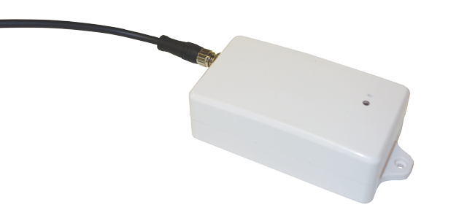
Asset Tracker Wired (AT1 Wired)
Key Features
One of the market’s smallest and most affordable asset trackers
Captures humidity, temperature, light, and impact stats
Applicable to any non-powered device
Quick and easy install
Easy to disguise and install covertly
Built-in sensors: Ambient Temperature, Humidity, Light, Impact, Motion
Best Practice
DDS is only configurable in FC Web
Mount outside (not inside an asset)
Mount clear from obstructions, clear line of sight to the satellites
Vehicles with special coating on glass can limit reporting
Unit should not be covered with primer or metallic paint
Technical Specifications
Battery Life: 1,500 events - Default 1 ping a day
Rechargeable battery with 9 ft of cable; 4 hours to start reporting, 35-50 hours to full charge
Humidity: Absolute accuracy ±3% Relative Humidity
Temperature: -40 to +185˚F; Absolute accuracy ±0.9˚F
Light: Solid and white translucent variant for light sensitivity
Enclosure: IP67 rugged water and dust proof

Slide 10
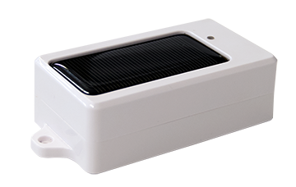
Asset Tracker Solar (AT1 Solar)
Key Features
Runs on LTE-M, low power network
One of the market’s most adaptable and affordable asset trackers
Captures humidity, temperature, light, and impact stats
Applicable to any non-powered device
Solar powered
Quick and easy install
Best Practice
Motion will consume additional battery power
How long will it last on one change? Depending on DDS, Motion & Temperature reporting
Mounting – Recommended to be mounted on angle in areas with heavy snow fall
Technical Specifications
Battery Life: 1,500 events - Default 1 ping a day
Recharges under direct sunlight; 4 hours to start reporting, 35-50 hours to full charge
Humidity: Absolute accuracy ±3% Relative Humidity
Temperature: -30˚C — +85˚C (-40 to +185˚F); Absolute accuracy ±0.9˚F
Light: Solid and white translucent variant for light sensitivity
Enclosure: IP67 rugged water and dust proof

Slide 11
Device Comparison
Feature | AT1 Wired | AT1 Solar
Antenna | Internal | Internal
Position accuracy | 8ft | 8ft
Operating temperature | -30˚C — +65˚ C (-22 — +149° F) | -30˚C — +65˚ C (-22 — +149° F)
Rechargeable back-up battery |  | 
Back-up battery life (Based on a full charge) | 1,500 events | 1,500 events Rechargeable
Battery recharge temperature | 0˚C — +45˚C (32° — +113° C) | 0˚C — +45˚C (32° — +113° C)
Enclosure | IP67 | IP67
Power source | Lithium-Polymer battery | Lithium-Polymer battery
Built-in sensors | Temperature, Humidity, Light, Impact, Motion | Temperature, Humidity, Light, Impact, Motion
Warranty | 1 yr. | 1 yr.
Default transmission frequency | Default: 1 ping in 24 hours | Default: 1 ping in 24 hours

Slide 12
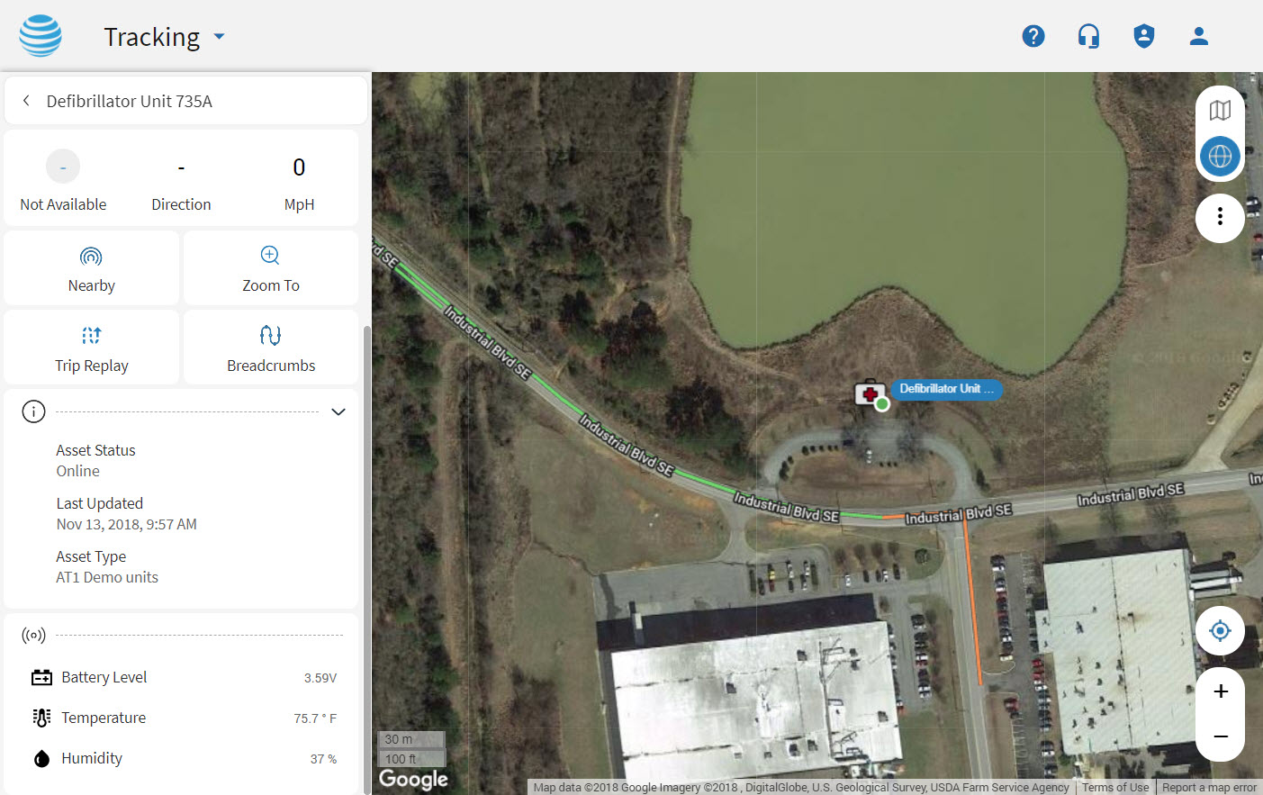
Implementation Requirements
Machinery or high-value asset
Asset Tracker mounted on the equipment that you would like to track.
Covertly installed on the asset using double-sided tape or screws.
Office Back-end
Unlimited AT&T Fleet Complete user accounts.
Browser-based or Desktop-based.
Unlimited complementary training is recommended.

Slide 13
Unique Applications Use Case

Slide 14
Public Safety
AT1 Solar
Notifications of forgotten equipment at a site
Alerts to sensitive equipment being tilted or dislodged during transport
Onsite departure equipment inventory sign off

Slide 15
Heavy Duty Equipment
AT1 Wired and AT1 Solar
Automated inventory reports of expensive tools and onsite equipment
Location and engine hours report for stationary, powered equipment
Notifications of equipment movement outside the jobsite

Slide 16
Distribution and Logistics
AT1 Solar
Alerts to spikes in temperature, humidity, or light exposure
Monitoring of the container door status

Slide 17
Stationary Powered Site Equipment
AT1 Wired
Report on engine hours
Notifications of fuel level threshold, signaling the need for refueling

Slide 18
Smart Agriculture
AT1 Solar
Rule-based reporting on humidity, light exposure, and temperature status
Trigger events, like irrigation, when exact conditions are met
Optimize crop yield and quality

Slide 19
Recommended FC Web Rules
The following recommended Rules are available and can be assigned to your AT1 device to notify you of any changes:
Analog
Is used to determine when an asset sensor reading is outside of a specified range. Low battery rule at 3.52V (300 pings remaining).
Temperature
Is used with a temperature sensor to inform you about when the temperate is outside of a specific range.
Distance
Is used to determine when an asset moves beyond a specified extent or amount of space.

Slide 20
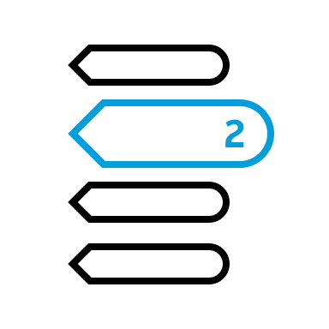
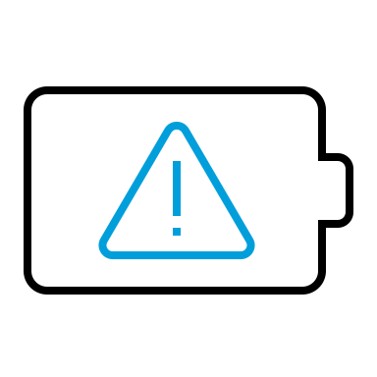
Recommended FC Web Reports
The following Reports are available for the AT1:
Temperature Report
Provides the temperature readings within a given time period.
Breadcrumb Trail
Is a summary that is available from the Tracking screen’s right-click menu for a specified asset.
Position Report
Snapshot taken for assets during specified dates/times.
Activity Report
Details of asset activities such as Start Location, End Location, POI, Speed, Distance etc.
Event
This reports when an event was triggered. For example AT1 Low Battery Rule.
Last Position
Report includes the last snapshot time and location of assets (Latitude, Longitude also includes Battery level).

Slide 21
IP Rated Enclosures Explained
What is an IP rating?
IP (or "Ingress Protection") ratings are defined in international standard EN 60529 (British BS EN 60529:1992, European IEC 60509:1989).
They are used to define levels of sealing effectiveness of electrical enclosures against intrusion from foreign bodies and moisture.
IP67
Protected from total dust ingress
Protected from immersion between 15 centimetres and 1 metre in depth, limited ingress protection
AT1 Wired
AT1 Solar
AT&T Fleet Complete provides a warranty on its hardware devices against defects in material and workmanship, with the exception of defects caused by abuse, misuse, accident, alteration, modification, neglect or incorrect installation, operation or removal of the equipment, for a period of one (1) year from the date of installation or purchase. Warranty shall not apply if this product casing is opened or tampered with.

Slide 22
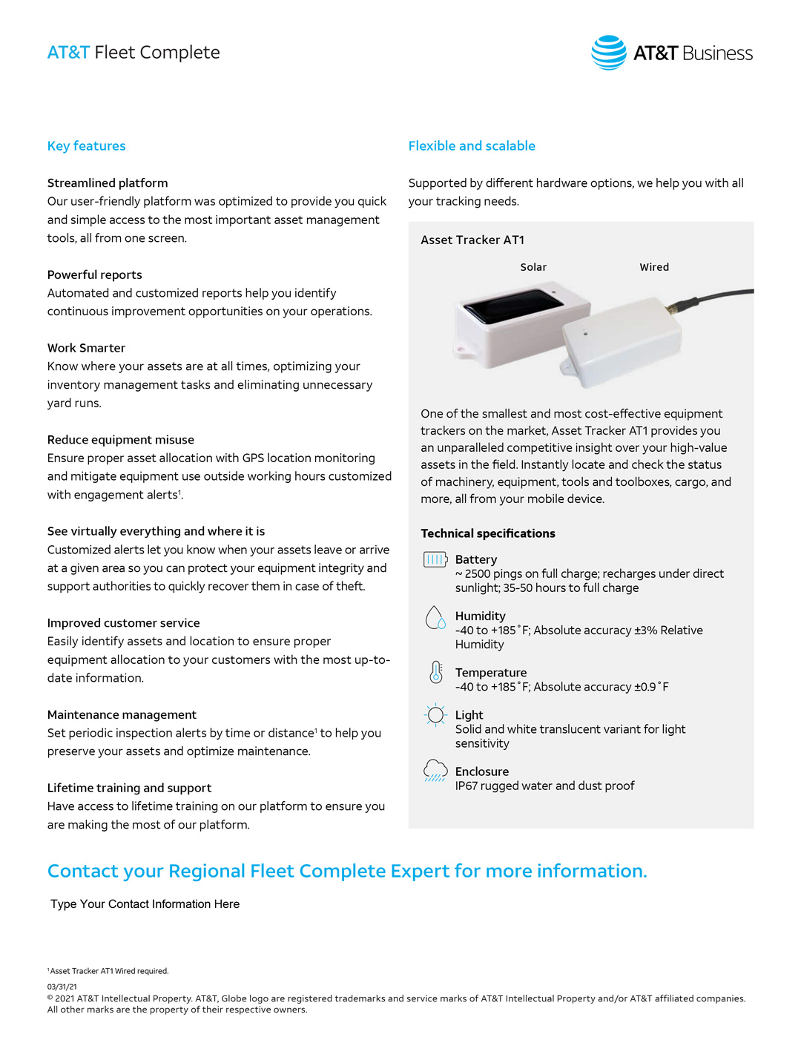

Slide 24
Important Information
AT&T Fleet Complete® is only available to customers with a Qualified AT&T business or government agreement and a Foundation Account Number (FAN) and their respective CRUs. Activation of an eligible AT&T wireless rate plan on a compatible device is required. May not be available for purchase in all areas or through all channels. Coverage not available in all areas. Availability, security, speed, timeliness, accuracy and uninterrupted use of service are not guaranteed. Not all features available on all devices. Compatible device required for GPS or a GPS derived location information. Activating data blocking features will result in Cell ID or Enhanced Cell ID location information only. AT&T Fleet Complete® is subject to Complete Innovations’ additional terms and conditions, including without limitation its software license. Such terms and conditions are available at http://www.fleetcomplete.com/end-user-license-agreement-for-fleet-complete/. Additional hardware, software, services, internet access and/or special network connection may be required.
Additional charges, terms, conditions and restrictions may apply. Offer and pricing subject to change without notice. AT&T privacy policy may be viewed at http://www.att.com/privacy.

