Slide 1
Fleet Complete Demos For Retail
Instructions on to
how to play Fleet
Complete Sales and
Demo Videos on loop
on the Sales Floor

Slide 2
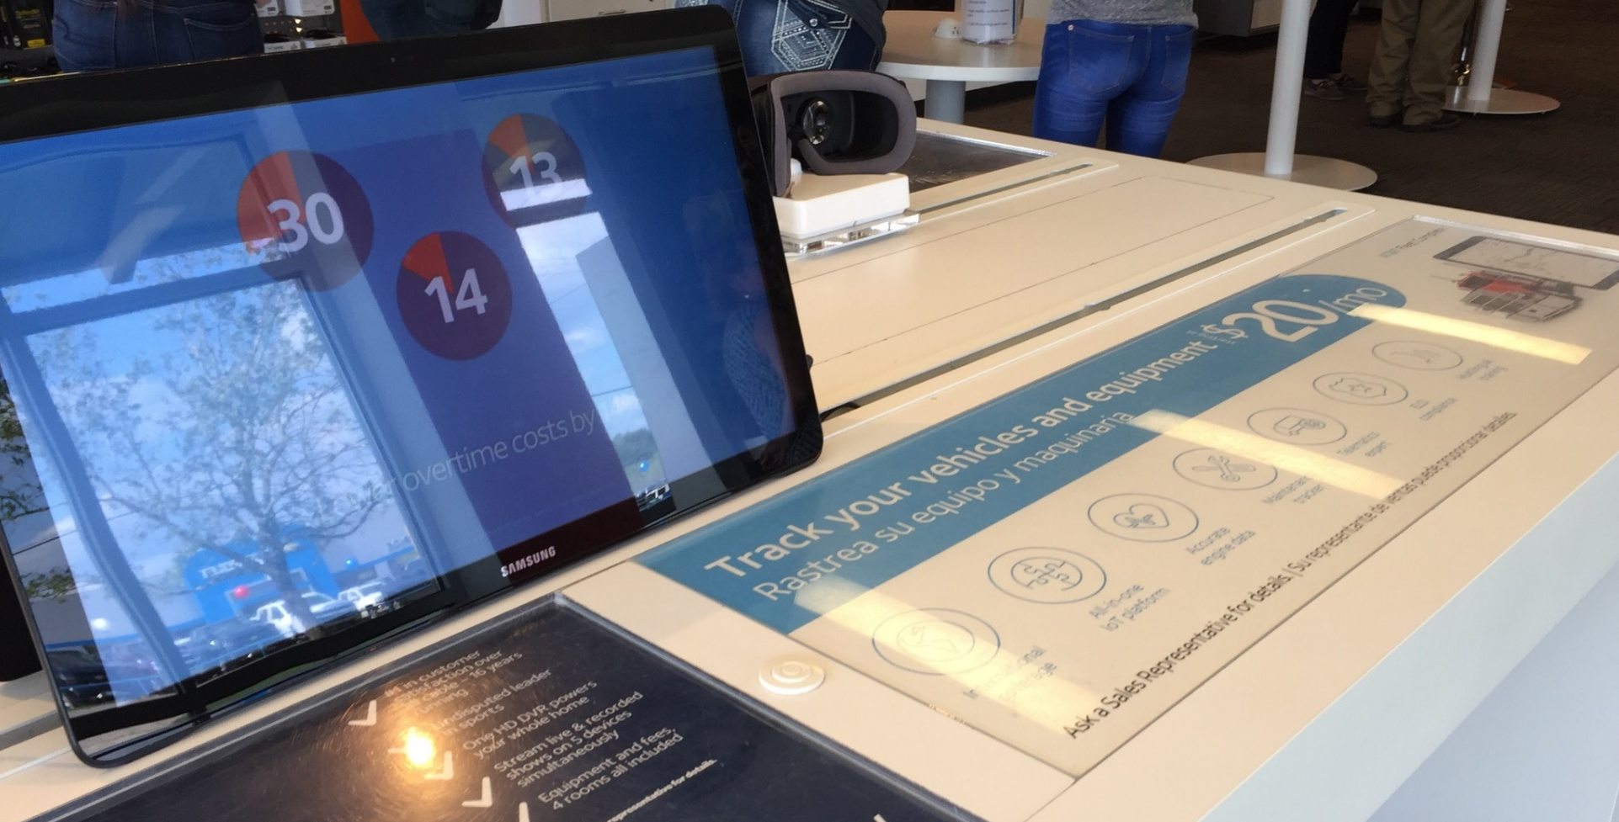
Pick a phone or tablet to play the video on
Select device that does not have Device Alive, Mobile Iron, or any other software that locks the device down or already plays videos on a loop.
Otherwise, you will need to factory reset the device to remove these applications.

Slide 3
IOS Instructions

Slide 4
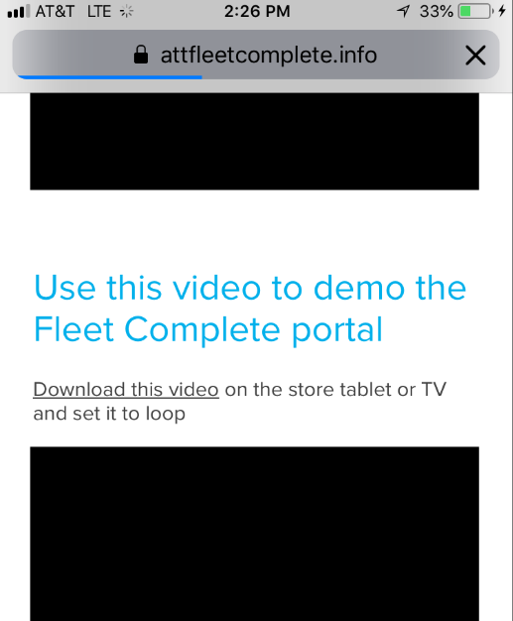
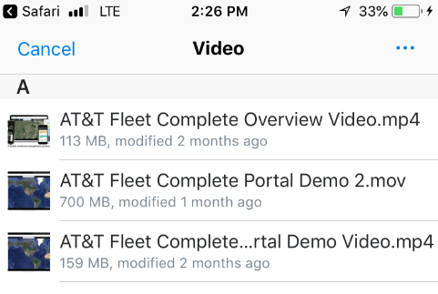
Visit att.fleetcomplete.com/sales from Safari
Follow the link to our Drop Box site to see Fleet Complete videos for retail. Select the .mp4 videos you would like to play

Slide 5
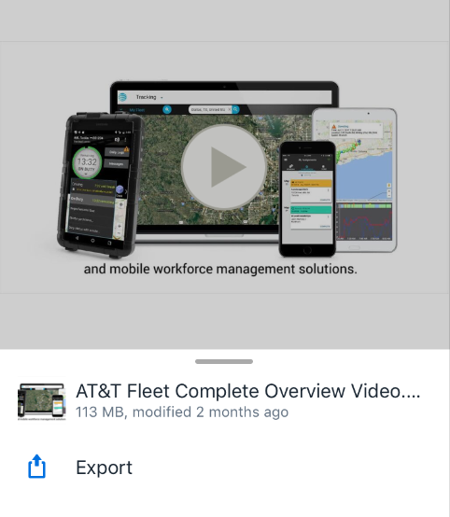
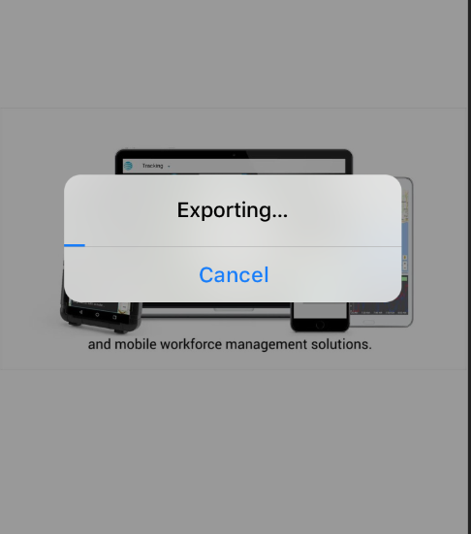
Export the video to photos

Slide 6
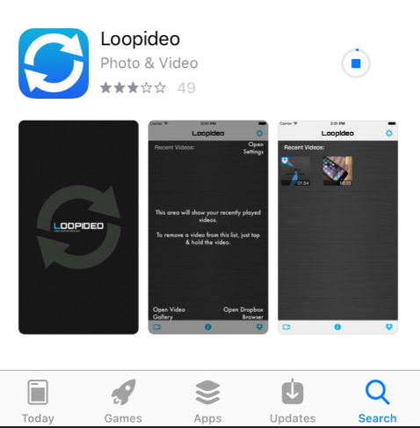
Download Loopideo from the app store

Slide 7
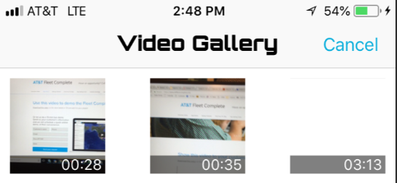
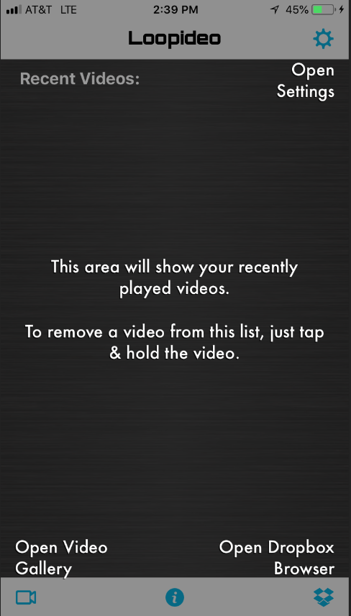
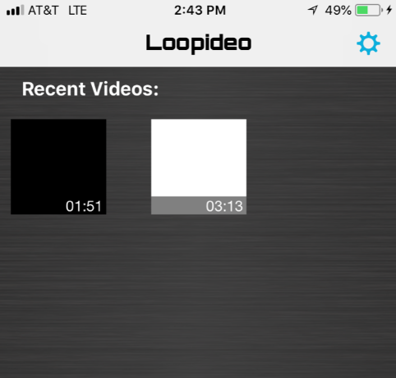
Add Videos to Loopideo

Slide 8
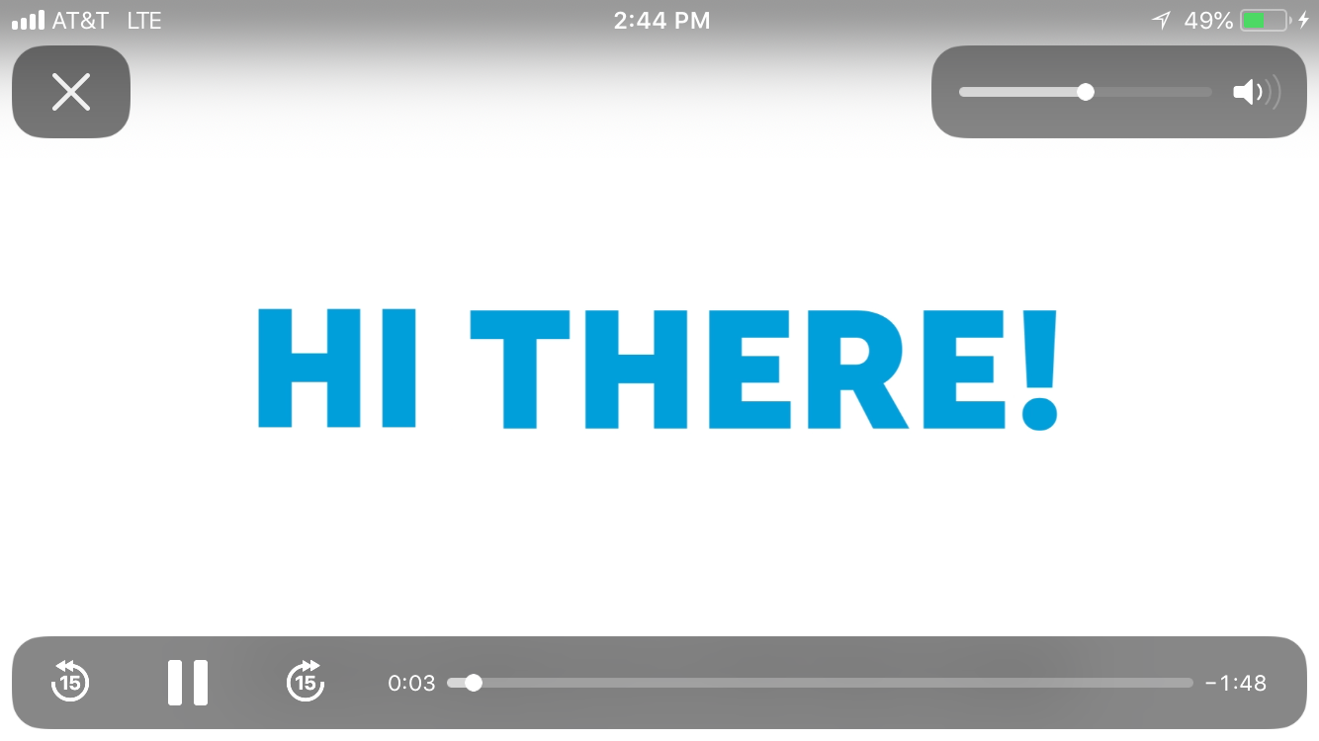
Click play on the video and let it run! (loopideo needs remain open to play)

Slide 9
Android Instructions

Slide 10
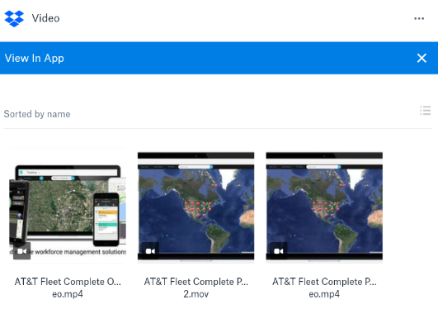
Visit att.fleetcomplete.com/sales from chrome
Follow the link to our Drop Box site to see Fleet Complete videos for retail. Select the .mp4 videos you would like to play

Slide 11
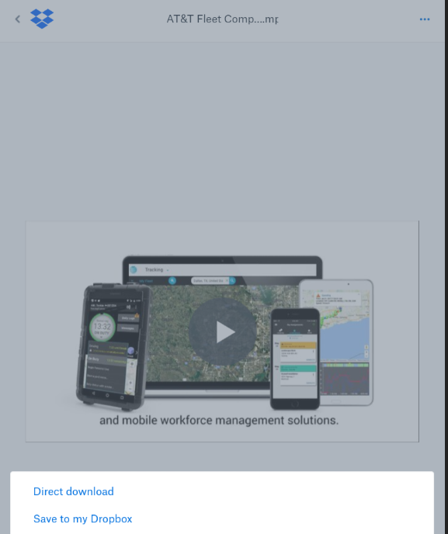
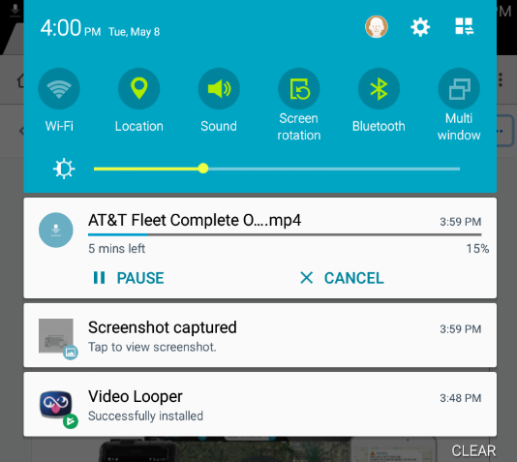
Export the video

Slide 12
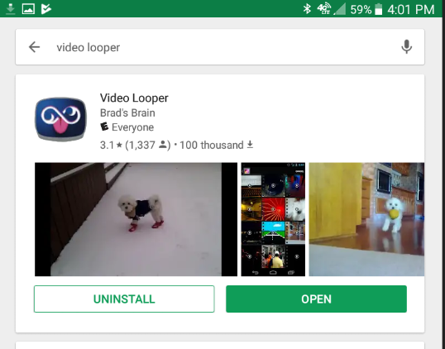
Download Video Looper from the playstore

Slide 13
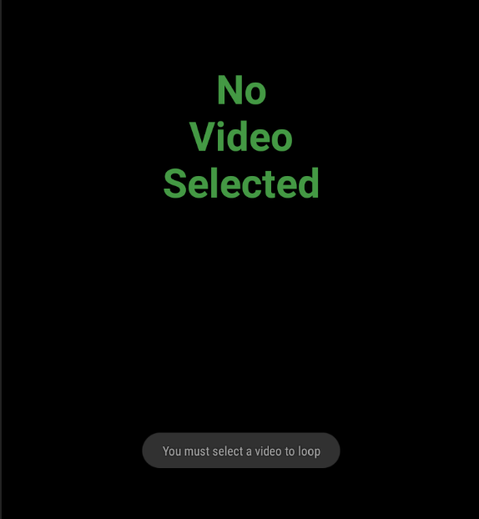
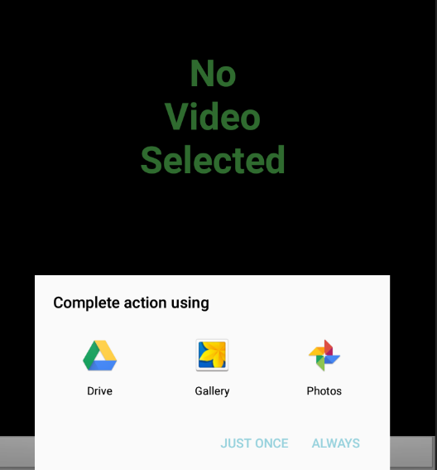
Add Videos to Video Looper

Slide 14
Click play on the video and let it run! (Video Looper needs remain open to play)

