Slide 1
Asset tracker (at1) LTE-M for FirstNet

Slide 2
Agenda
Evaluating Your Assets
  Features and Benefits
  Innovative Solutions for Diverse Needs
  Cost of lost or Stolen Assets
Versatile Industry Solutions
  Things to consider
  Flexible applications
  Features and benefits
Products
  AT1 Wired
  AT1 Solar
  Comparison

Slide 3
Features and Benefits
LTE-M for FirstNet
Industry-leading asset tracking technology
Installation in Seconds
Using double-sided tape or screws device is quick to install on any asset
Asset Tracking
Integrated Sensors
Humidity, light, and temperature sensors
Small Size
One of smallest tracking devices on the market
End to End System
Device, cloud IT, applications, security, connectivity and customer support
Low-Cost Solution
Bundle with FC software and data plan for $10/month
© 2021 AT&T Intellectual Property. All rights reserved. FirstNet, and the FirstNet logo are registered trademarks and service marks of the First Responder Network Authority. All other marks are the property of their respective owners.

Slide 4

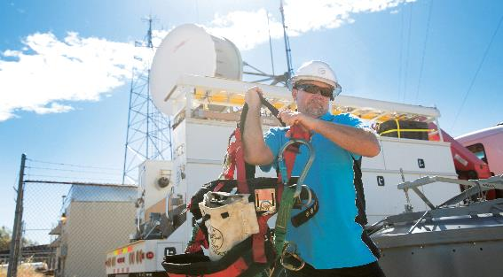

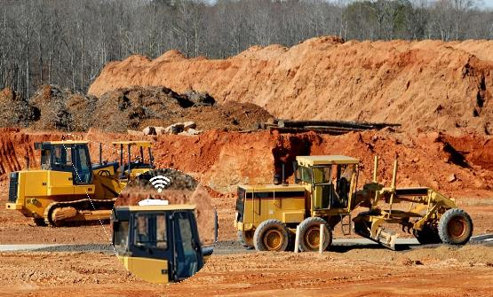
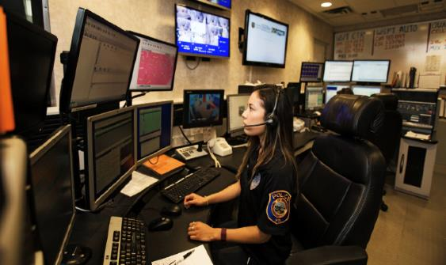
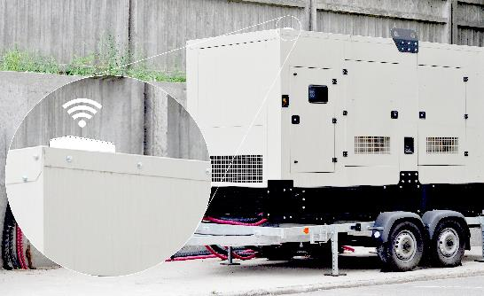
Innovative solutions for diverse Business needs
Transportation
Utility
Healthcare
Construction
Public Safety
High-Value Inventory

Slide 5

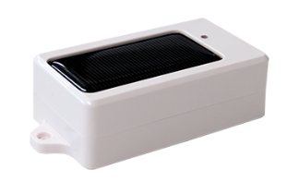
Transportation
AT1 Solar
Problem: Locating storage containers can be inefficient and delay distribution timelines.
Cause: Transportation in a supply chain requires streamline movement of products from one location to the next.
Solution: Monitoring alerts and checking status of the container’s condition, including movement, door status and temperature spikes helps to ensure optimal operation.
Benefit: A single platform to organize, track, and monitor your assets through the transportation supply chain process.

Slide 6
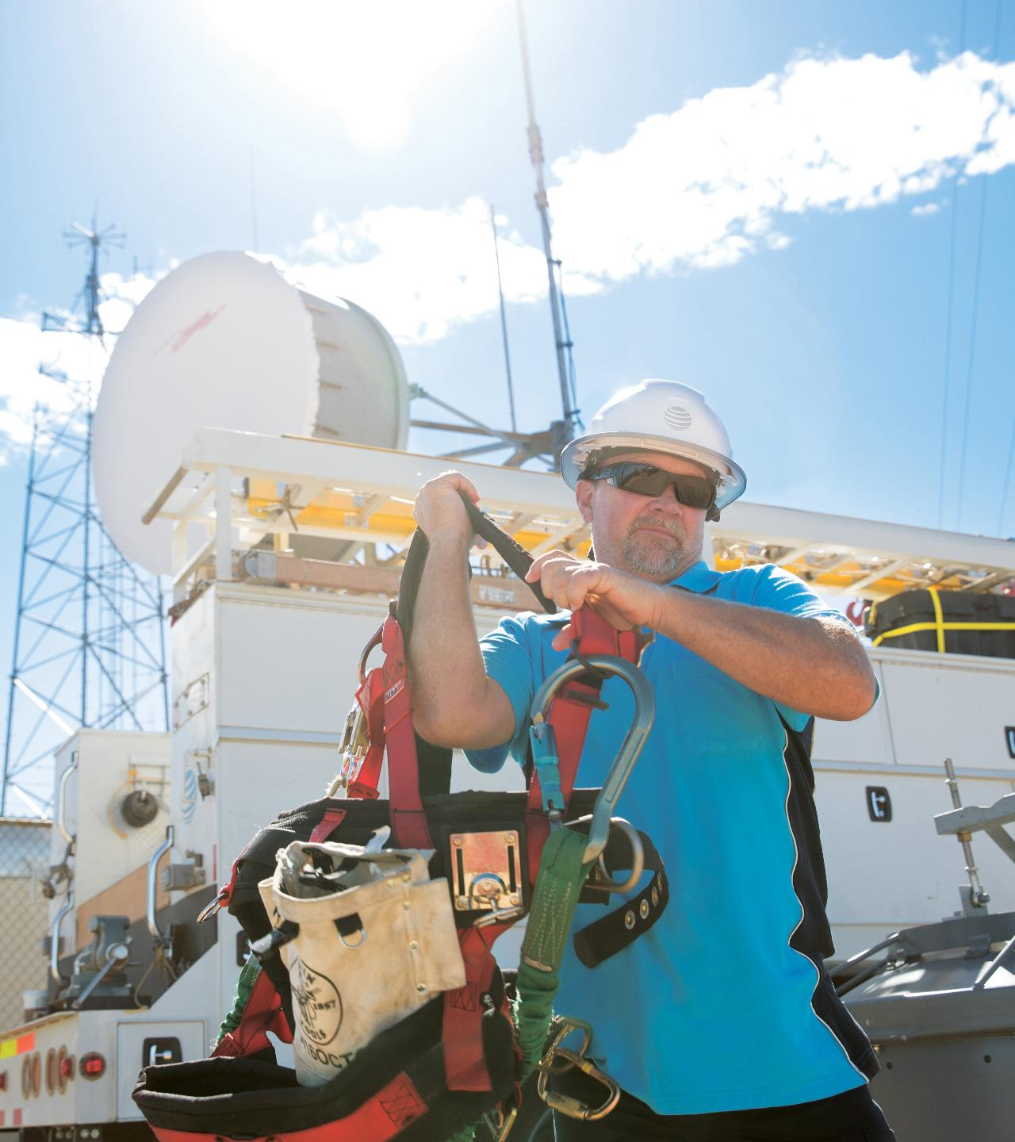
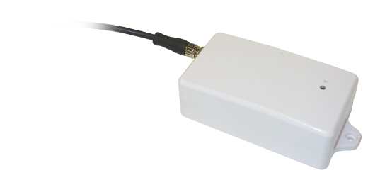
Utility
AT1 Wired
Problem: Natural disasters cause disruption in services such as power, gas and water, leading to impacted health and welfare.
Cause: Emergency responders rely on utility companies to ensure that critical infrastructure and facilities are operating correctly.
Solution: Having a single view of assets increases situational awareness helps to ensure utility yards and companies quickly deploy equipment to multiple locations during a crisis.
Benefit: Providing Position Reports or Breadcrumb Trails allows emergency response teams to locate the asset, and re-direct the equipment to a new location.

Slide 7

Healthcare
AT1 Solar
Problem: In the event of a medical emergency, the inability to locate medical equipment and ambulances can directly impact the outcome of the situation.
Cause: Response times are often critical and having access to equipment such as an automated external defibrillator (AED) or portable ultrasound machines can be life-saving.
Solution: Offering emergency responders enhanced visibility to efficiently assist patients and determine which medical equipment is accessible during a crisis.
Benefit: Equipping first responders to make swift, on the spot decisions for patients, and offer insight on medical equipment needed during any emergency.

Slide 8
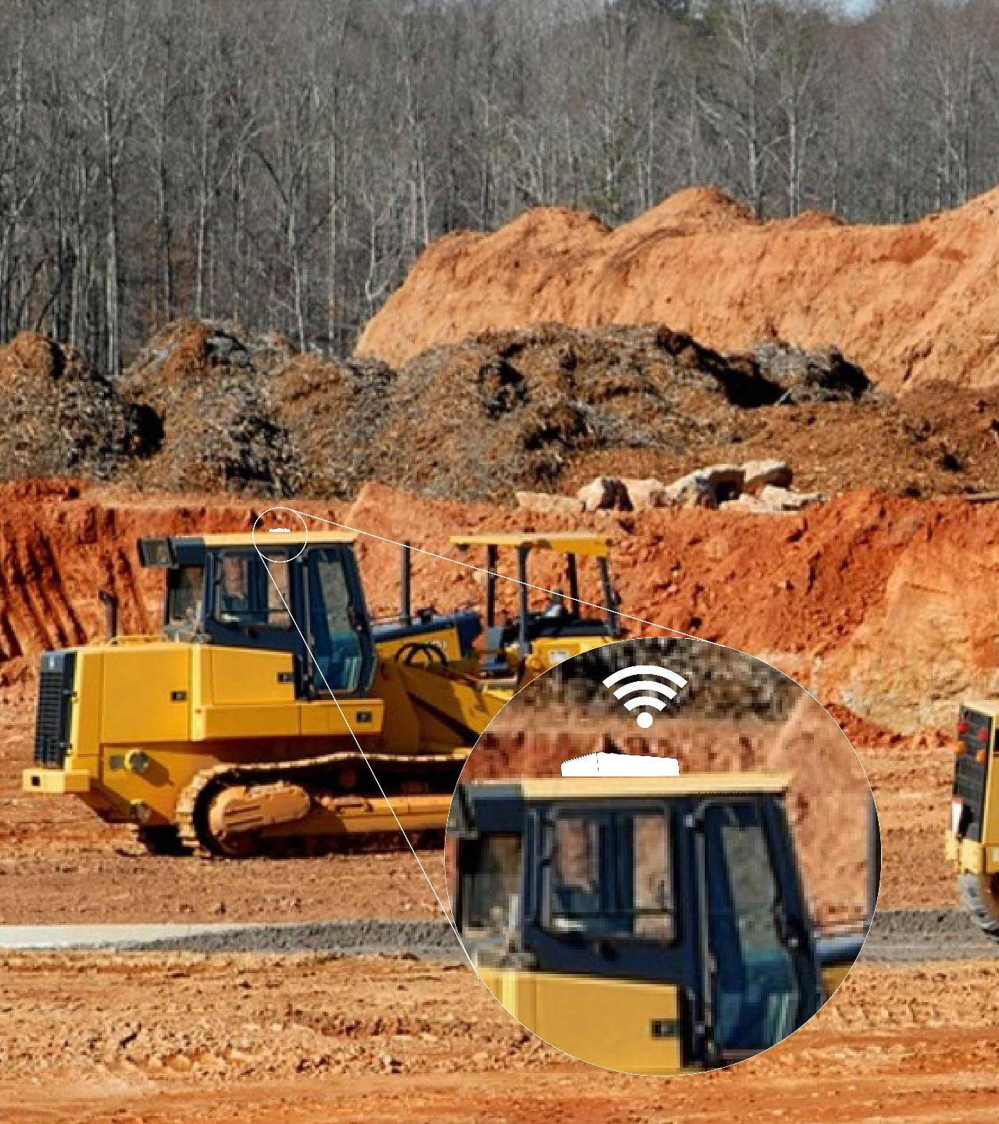
Construction
AT1 Wired
Problem: Assisting first responders in the recovery and removal of debris during a natural disaster is imperative to minimizing lasting effects on a community.
Cause: Tracking equipment and assets across multiple job sites can be challenging for first responder supported networks.
Solution: Installing asset trackers on equipment utilizes alerts and delivers rule-based reporting as machines navigate through disaster sites.
Benefit: Accurately capturing the time and location of assets to help ensure availability of equipment.

Slide 9
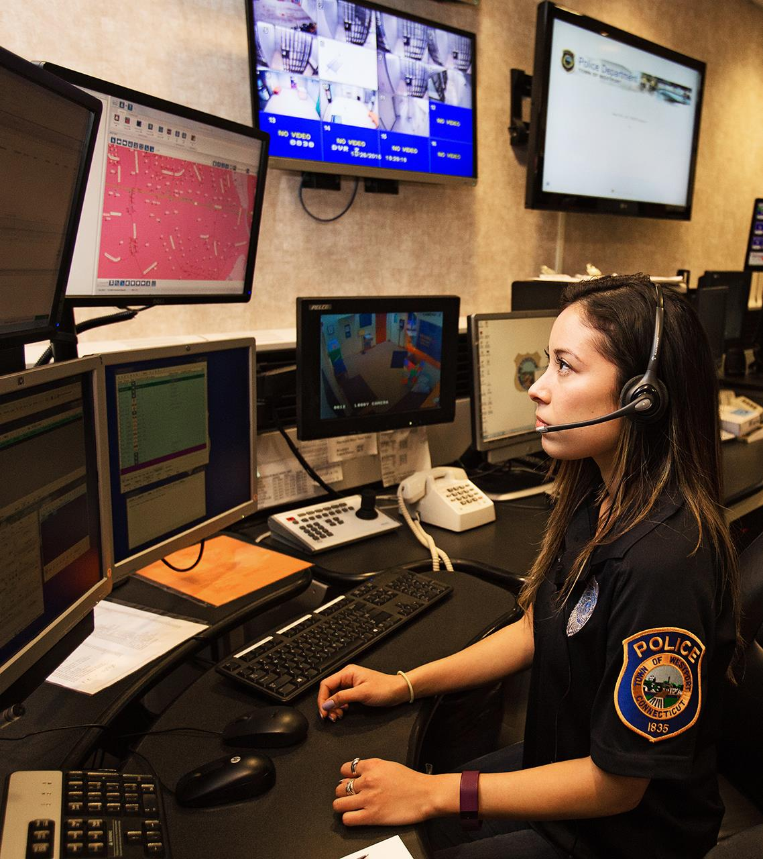
Public safety
AT1 Solar
Problem: Being prepared for a crisis at any given time is in all emergency management's playbook, however, maintaining the status of available assets can often be challenging.
Cause: Many cities, towns and municipalities utilize shared assets for emergency management needs, making the need to quickly locate equipment imperative.
Solution: Offering emergency crisis teams alerts and visibility to track shared assets from neighboring departments for quick deployment.
Benefit: Public Safety departments will benefit from using one single back-office platform with unlimited Fleet Complete user capability, creating clear visibility and optimizing performance capturing in near real-time insights.

Slide 10
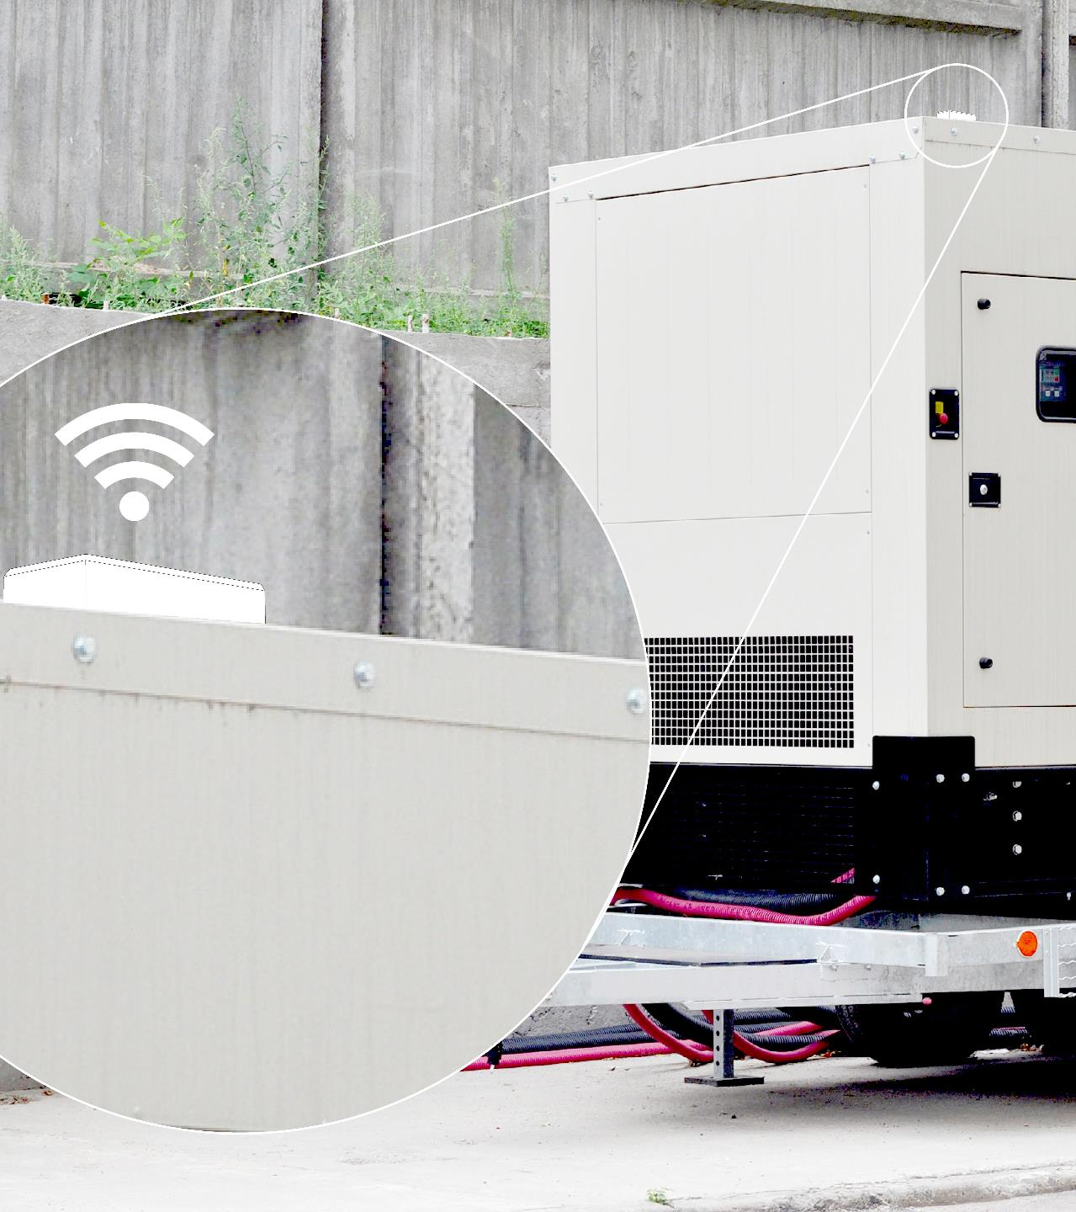
High-Value
Inventory
AT1 Wired
Problem: During a state of emergency, locating or deploying trailer-based generators without location awareness can lead to inefficient asset utilization.
Cause: Inaccurate asset reporting or equipment that is scheduled for maintenance can delay deployment of an asset to a location in need of power.
Solution: Securely mounted asset trackers deliver precise reporting on location, motion, and impact.
Benefit: Tracking engine hours and fuel level thresholds contributes to power sustainability through a state of emergency.

Slide 11
Evaluating Your Assets

Slide 12
Cost of Underperforming Assets
How often are your assets unaccounted for during a project or incident that’s underway?
• Inefficient asset utilization
• Increased inventory costs
• Inaccurate productivity reporting
• Manual performance assessment
• Delayed equipment inventory reports
• Needless paper trail and man hours
• Unknown ROI for each asset

Slide 13
Products

Slide 14

Asset Tracker Wired (AT1 Wired)
Key Features
  One of the market’s smallest and most affordable asset trackers
  Captures humidity, temperature, light, and impact stats
  Applicable to any non-powered device
  Quick and easy install
  Easy to disguise and install covertly
  Built-in sensors: ambient temperature, humidity, light, impact, motion
  Best Practice
  DDS is only configurable in FC Web
  Mount outside (not inside an asset)
  Mount clear from obstructions, clear line of sight to the satellites
  Vehicles with special coating on glass can limit reporting
  Unit should not be covered with primer or metallic paint
  Technical Specifications
Battery Life: ~1500 events - Default 1 ping a day
  Rechargeable battery with 9 ft of cable; 5 hours to start reporting, 35-50 hours to full charge
Humidity: Absolute accuracy ±3% Relative Humidity
Temperature: -40 to +185˚F; Absolute accuracy ±0.9˚F
Light: Solid and white translucent variant for light sensitivity
Enclosure: IP67 rugged water and dust proof
AT&T Fleet Complete provides a warranty on its hardware devices against defects in material and workmanship, with the exception of defects caused by abuse, misuse, accident, alteration, modification, neglect or incorrect installation, operation or removal of the equipment, for a period of one (1) year from the date of installation or purchase. Warranty shall not apply if this product casing is opened or tampered with.

Slide 15
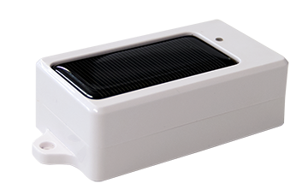
Asset Tracker Solar (AT1 Solar)
Key Features
  Runs on LTE-M, low power network
  One of the market’s most adaptable and affordable asset trackers
  Captures humidity, temperature, light, and impact stats
  Applicable to any non-powered device
  Solar powered
  Quick and easy install
  Best Practice
  Motion will consume additional battery power
  How long will it last on one change? Depending on DDS, motion & temperature reporting
  Mounting – Recommended to be mounted on angle in areas with heavy snow fall
  Technical Specifications
Battery Life: ~1500 events - Default 1 ping a day
  Recharges under direct sunlight; 5 hours to start reporting, 35-50 hours to full charge
Humidity: Absolute accuracy ±3% Relative Humidity
Temperature: -30˚C — +65˚C (-40 to +185˚F); Absolute accuracy ±0.9˚F
Light: Solid and white translucent variant for light sensitivity
Enclosure: IP67 rugged water and dust proof
AT&T Fleet Complete provides a warranty on its hardware devices against defects in material and workmanship, with the exception of defects caused by abuse, misuse, accident, alteration, modification, neglect or incorrect installation, operation or removal of the equipment, for a period of one (1) year from the date of installation or purchase. Warranty shall not apply if this product casing is opened or tampered with.

Slide 16


Device Comparison
Feature | AT1 Wired | AT1 Solar
Antenna | Internal | Internal
Position accuracy | 8ft | 8ft
Operating temperature | -30˚C — +65˚ C (-40 - +185° F) | -30˚C — +65˚ C (-40 - +185° F)
Rechargeable back-up battery |  | 
Back-up battery life (Based on a full charge) | -1500 events | ~ 1500 events Rechargeable
Battery recharge temperature | 0˚C — +45˚C (32° — +113° C) | 0˚C — +45˚C (32° — +113° C)
Enclosure | IP67 | IP67
Power source | Lithium-Polymer battery | Lithium-Polymer battery
Built-in sensors | Temperature, Humidity, Light, Impact, Motion | Temperature, Humidity, Light, Impact, Motion
Warranty | 1 yr. | 1 yr.
Default transmission frequency | Default: 1 ping in 24 hours | Default: 1 ping in 24 hours
AT&T Fleet Complete provides a warranty on its hardware devices against defects in material and workmanship, with the exception of defects caused by abuse, misuse, accident, alteration, modification, neglect or incorrect installation, operation or removal of the equipment, for a period of one (1) year from the date of installation or purchase. Warranty shall not apply if this product casing is opened or tampered with.

Slide 17
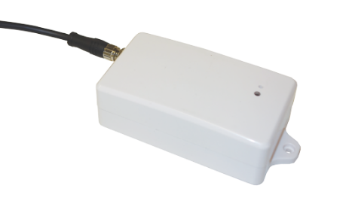

IP Rated Enclosures Explained
What is an IP rating?
  IP (or "Ingress Protection") ratings are defined in international standard EN 60529 (British BS EN 60529:1992, European IEC 60509:1989)
  They are used to define levels of sealing effectiveness of electrical enclosures against intrusion from foreign bodies and moisture.
IP67
Protected from total dust ingress
Protected from immersion between 15 centimetres and 1 metre in depth, limited ingress protection
AT1 Wired
AT1 Solar
AT&T Fleet Complete provides a warranty on its hardware devices against defects in material and workmanship, with the exception of defects caused by abuse, misuse, accident, alteration, modification, neglect or incorrect installation, operation or removal of the equipment, for a period of one (1) year from the date of installation or purchase. Warranty shall not apply if this product casing is opened or tampered with.

Slide 18

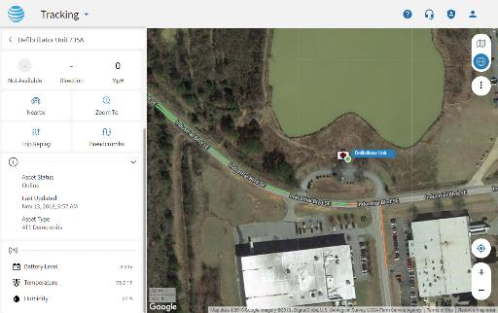

Implementation Requirements
Machinery or High-Value Asset
  Asset Tracker mounted on the equipment that you would like to track
  Covertly installed on the asset using double-sided tape or screws
    Office Back-End
  Unlimited AT&T Fleet Complete user accounts
  Browser-based or Desktop-based
  1 - 3 complementary training sessions
AT&T Fleet Complete provides a warranty on its hardware devices against defects in material and workmanship, with the exception of defects caused by abuse, misuse, accident, alteration, modification, neglect or incorrect installation, operation or removal of the equipment, for a period of one (1) year from the date of installation or purchase. Warranty shall not apply if this product casing is opened or tampered with.

Slide 19
Recommended FC Web Reports
The following Reports are available for the AT1:
Temperature Report
  Provides the temperature readings within a given time period.
Breadcrumb Trail
  Is a summary that is available from the Tracking screen’s right-click menu for a specified asset.
Position Report
  Snapshot taken for assets during specified dates/times.
Activity Report
  Details of asset activities such as Start Location, End Location, POI, Speed, Distance, etc.
Event
  This reports when an event was triggered. For example, AT1 Low Battery Rule.
Last Position
  Report includes the last snapshot time and location of assets (Latitude, Longitude also includes Battery level).

Slide 20

BUILT FOR YOU.
INSPIRED BY YOU.

