Slide 1
AT&T Fleet Complete Overview
November 26, 2021

Slide 2
AT&T Fleet Complete We’re uniquely qualified…
All-In-One Platform
Full range of fleet solutions – HOS, Fleet and Asset Tracking – all on one platform
North American Fleet Telematics Company of the Year
15 Countries
acclaimed by Frost & Sullivan

Slide 3
About Fleet Complete
Fleet Complete is a leading global provider of mission-critical connected technologies for fleet, asset and mobile workforce-based businesses.
Fleet Complete can….
Support simple to complex implementations with self-install to professional options
Provide scalable solutions from small business to enterprises and local governments
The most complete solution portfolio
Fleet Tracker
Asset Tracker
ELD Compliance
Task Tracker
Courier Complete
Inspect
Vision
Forms
Notes:
Whether you operate a commercial fleet, government fleet, or an over-the-road trucking fleet, AT&T Fleet Complete fleet management solutions provide the vehicle, asset tracking, and advanced monitoring tools your organization needs to send the information where it needs to go, so your mobile fleet can be more efficient, profitable, and customer-focused.

Slide 4
Target Markets
Services
Delivery
First Responders, Government & Education
Transportation
Construction

Slide 5
Customer Problems
Personal Errands and Side Jobs
After-hour use of company vehicles for personal errands increases fuel and maintenance expenses for the company.
High Fuel Costs
Every 6 mph over 60 mph decreases fuel economy by 10%.
Fines and Insurance Costs
Speeding tickets and accidents are resulting in increased insurance premiums for the company.
High Idling
Average truck uses almost half a gallon of fuel in Light Duty Vehicle / 1 Gallon for Heavy Duty Vehicle per hour of idling.
High FMCSA Fines
Lack of insight into driver status results in inefficient dispatching decisions, high fines and loss of business due to OOS penalties.
Timely Maintenance
Poorly running engines can use 10-20% more fuel.
Record Keeping
Paper trail associated with work orders, driver schedules, stops and maintenance schedules is costing in admin and management fees.
Lack of Visibility
Lost, stolen or poorly driven company vehicles are costing in maintenance, replacement, downtime and loss of business.
Loss of Billable Time
Inaccurate on-site arrival / departure times and personal errands during work hours add up to loss of billable time.
Insufficient Work Distribution
Inability to instantly see available drivers is costing in high phone traffic, unfair distribution of work and overtime costs.
Customer Service
Long response times, inability to provide ETAs, inaccuracies in billing due to lack of insight into time of arrival/departure result in poor customer service.
Remote Lone Drivers
Lack of visibility into vehicle location in remote areas for periods of time keeps managers and dispatchers in the dark about the status of the fleet.

Slide 6
Our Value Proposition
Fleet Complete’s fleet management applications serve as clients’ core operational system, enabling business transformation
Fleet vehicles
Mobile assets
Mobile workers
Helping Businesses
Improve Performance
Reduce Costs
Maintain Regulatory
Compliance
Enhance Customer Service
Enable Safe
Operations
Utilize Excess Capacity
Generate Revenue

Slide 7
Solution Across Industries
No matter what your fleet size, Fleet Complete can offer solutions for a single-operator to hundreds of vehicles.
Commercial Fleets
Government Fleets
Enterprise Fleets
Help maintain compliance with ELD and HOS
Oversee entire operations from one platform
Extensive accessories portfolio (temperature sensors, asset trackers, etc)
Customized solutions for business-specific needs
Project management, full-implementation management
Police, utilities, local governments, school buses
FirstNet solutions
Proactive maintenance scheduling, to ensure maximal vehicle uptime and levels of service.
Provide full transparency of your operations to your community
GM integration – no hardware installation required
Mixed-fleet solution
Driver behavior monitoring improves driver safety and company’s liability risks
Monitor vehicle use and idle time for instant cost savings

Slide 8
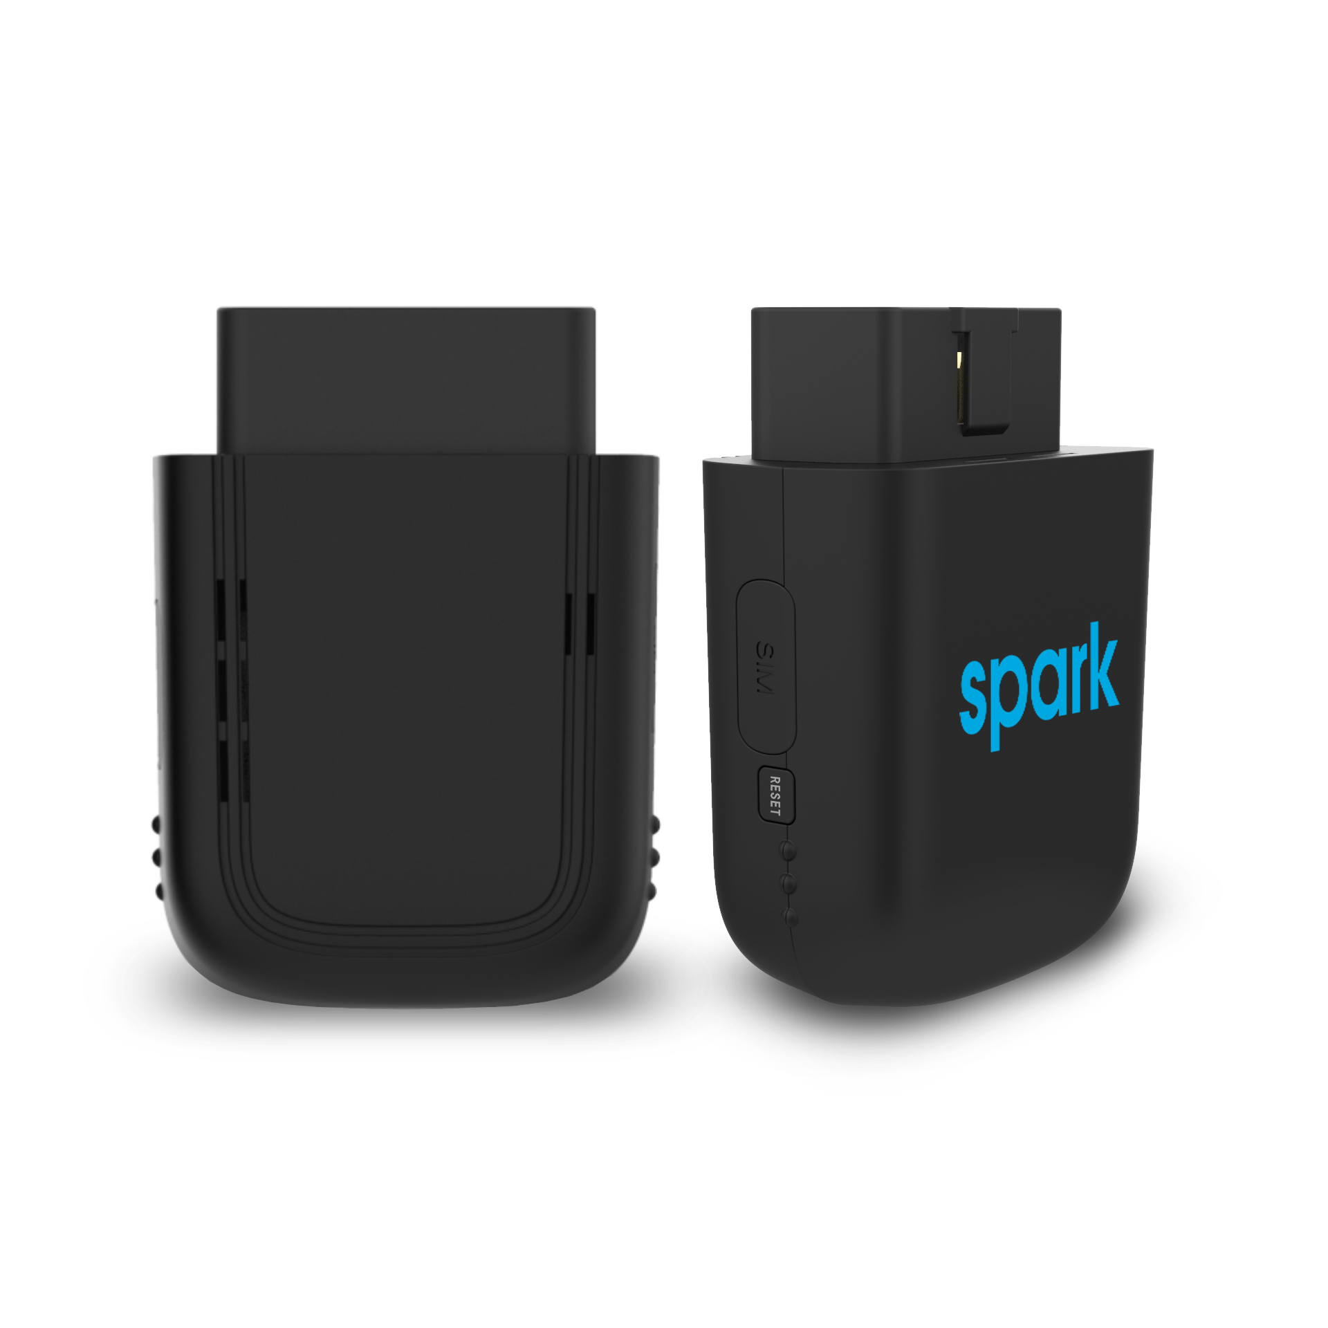
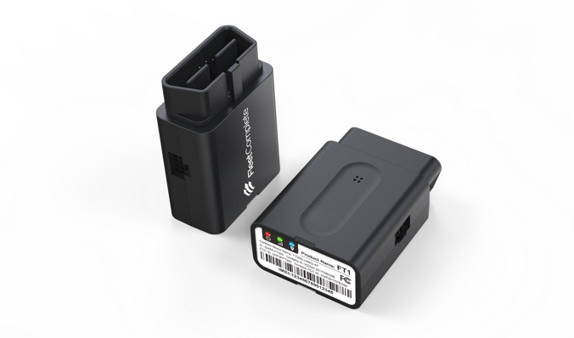
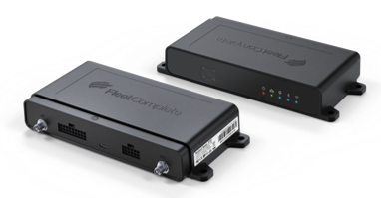
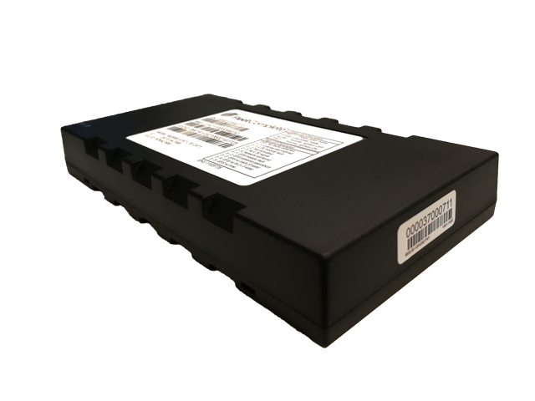
Fleet Tracking Hardware
Counts as Gross Add
Counts as Gross Add
Counts as Gross Add
Counts as FirstNet Gross Add
Fleet Tracker MGS800
Self or pro-install
Multiple connector types
In-vehicle tracking
Option sensors: temp, door, PTO, emergency button
Use Cases:
All heavy duty & light duty fleets
Yellow Iron
Spark (Harman)*
Easy plug & play installation
User-friendly platform
Band 14 FirstNet® Ready device
Wi-fi hotspot
Use Cases:
Light duty fleets
Extended Primary – Gov, Edu, Towing, Utilities
Fleet Tracker FT1
Plug & play dongle
Back up battery
Supports 1 input, 2 outputs and one wire
LTE-M and NB-IoT device
Use Cases:
Light duty fleets
FT2 FirstNet
Access to 700 Mhz Band 14​
Insights on critical fleet and in-field activities​
Supports First Priority® – priority, and pre-emption capabilities​
Cloud managed with full security stack​
ECM support for J1939 and OBDII for vehicle health and diagnostics reporting
Use Cases:
Primary – Police/Ambulance/Fire
Extended Primary – Gov, Edu, Towing, Utilities
* Spark (Harman) can also count as FirstNet Gross Add

Slide 9
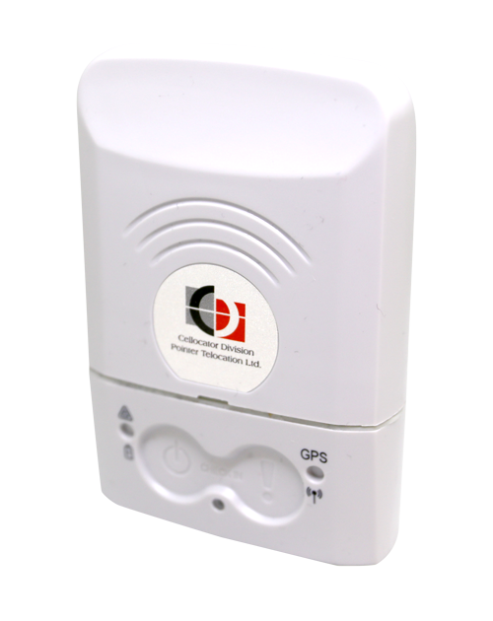
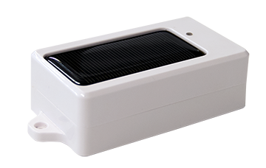
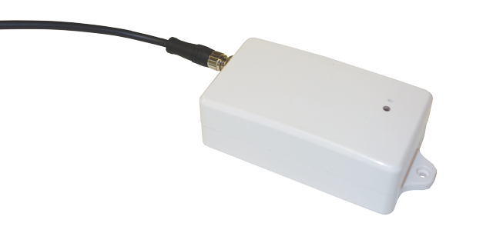
Asset Tracking Hardware
√
√
Counts as Gross Add
Counts as Gross Add
Counts as Gross Add
Asset Tracker Solar
Battery Life ~1500 events
Default 1 ping a day
Recharges under direct sunlight
Use Cases:
Trailers/storage
Construction
Asset Tracker Wired
Battery Life ~1500 events
Default 1 ping a day
Rechargeable battery with 9 ft of cable
Use Cases:
Construction equipment
Assets such as generators
PT100
2G/3G/LTE
Motion-activated
Small & lightweight device
Panic button

Slide 10
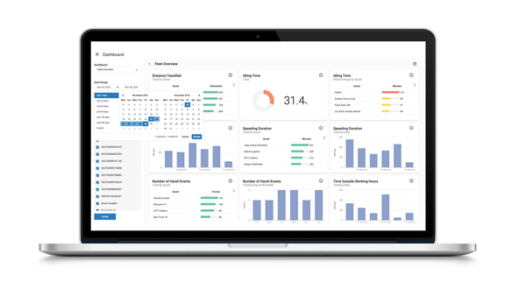
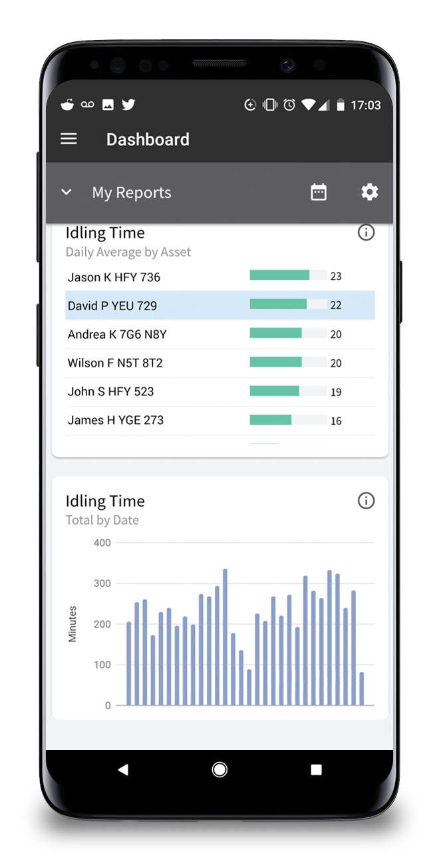
Fleet Tracker
Powerful telematics and driver behavior analytics tool.
Supported by a sophisticated GPS software, this user- friendly fleet tracking solution provides near real-time view on all of your fleet activities.
Performance dashboards and reports give fleet managers a critical overview of their fleet to help improve productivity, efficiency and safety.
Uncover cost-saving opportunities by continuously monitoring idle-time, off-hours driving, fuel economy, and more.
Increase your driver’s safety and reduce premature vehicle wear and tear by addressing aggressive driving patterns such as speeding and harsh braking with our driver behavior monitoring.
Extend your fleet’s lifetime and improve uptime with instant DTC code alerts or check engine notifications and schedule vehicle services before critical breakage occurs.

Slide 11
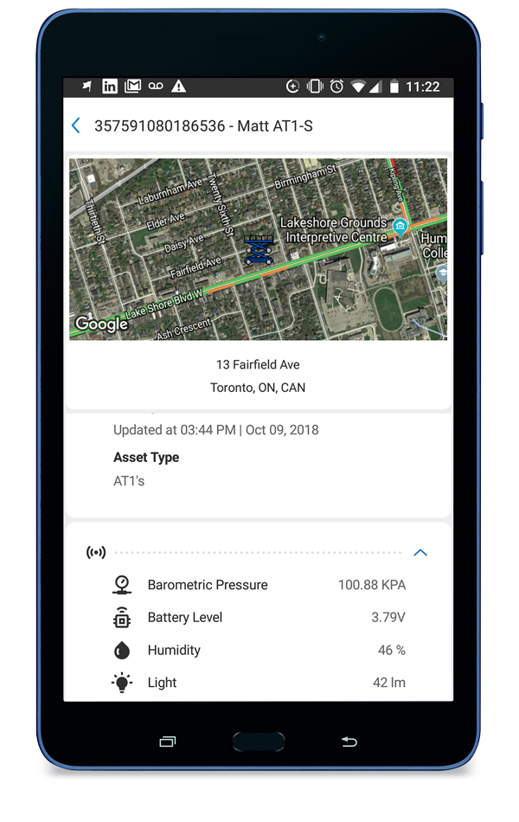
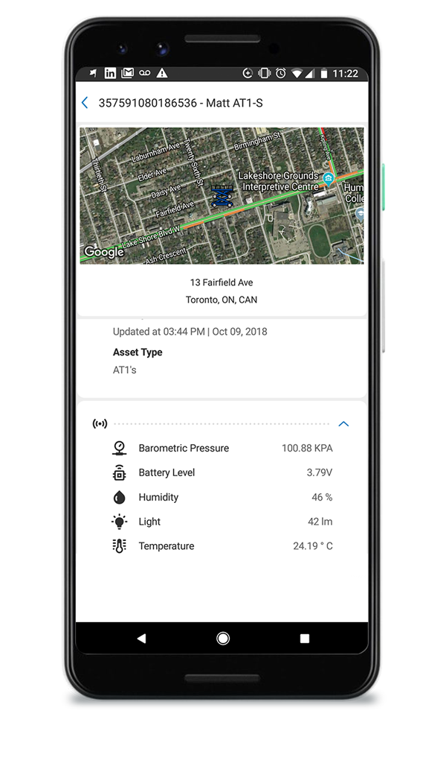
Asset Tracker
AT&T Fleet Complete Asset Trackers capture and transmit the asset’s location in the field. They are designed to monitor and report only on exceptions of the rule, such as when regularly stationary equipment is moved off-site outside of work hours.
AT&T Fleet Complete rules and reports are specifically designed to interpret the raw data and provide you an accurate picture of activity of your assets and equipment in the field.
Instantly locate and check the status of machinery, equipment, tools and toolboxes, cargo, and more, all from your mobile devices.
Calculate run time on your assets

Slide 12
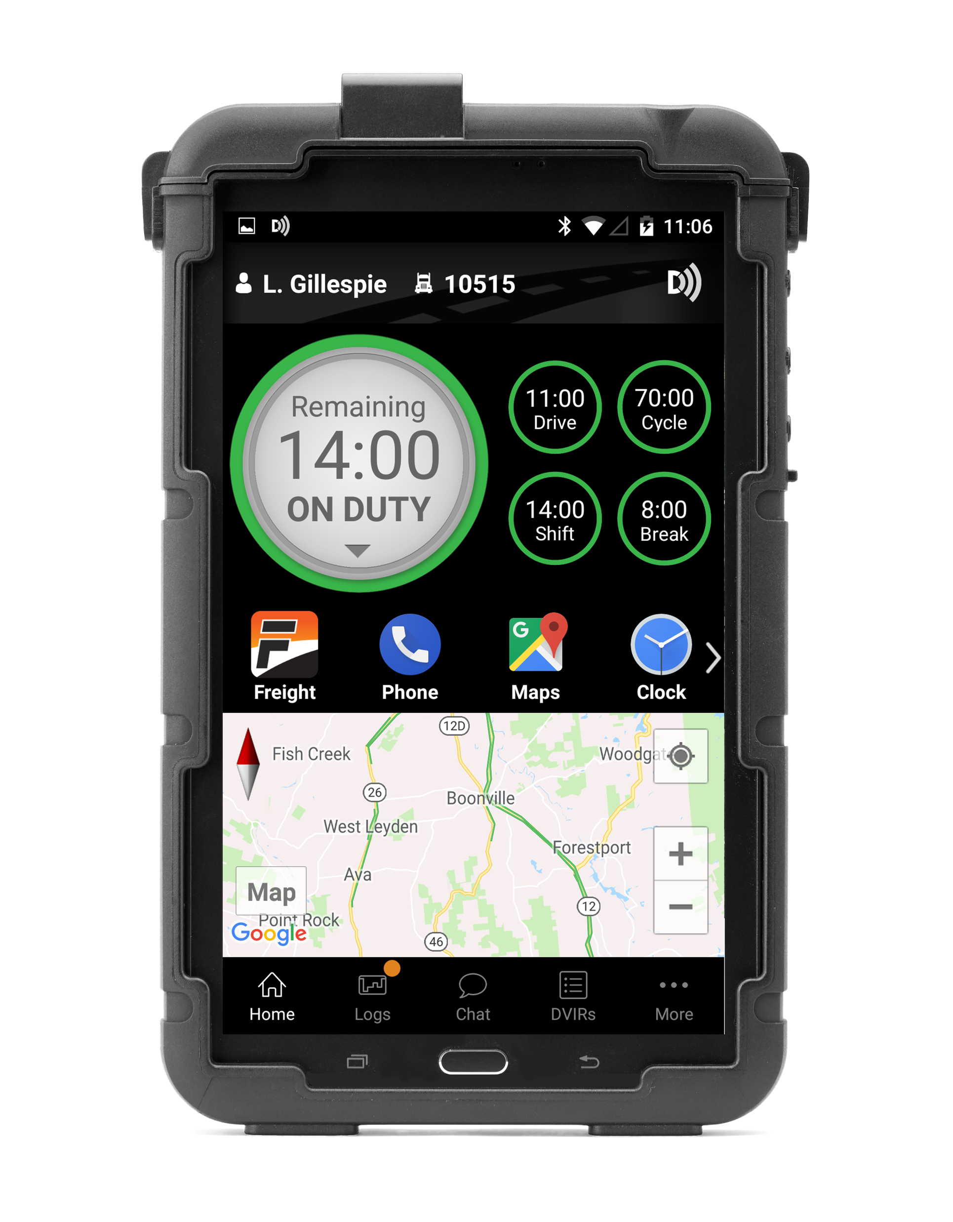
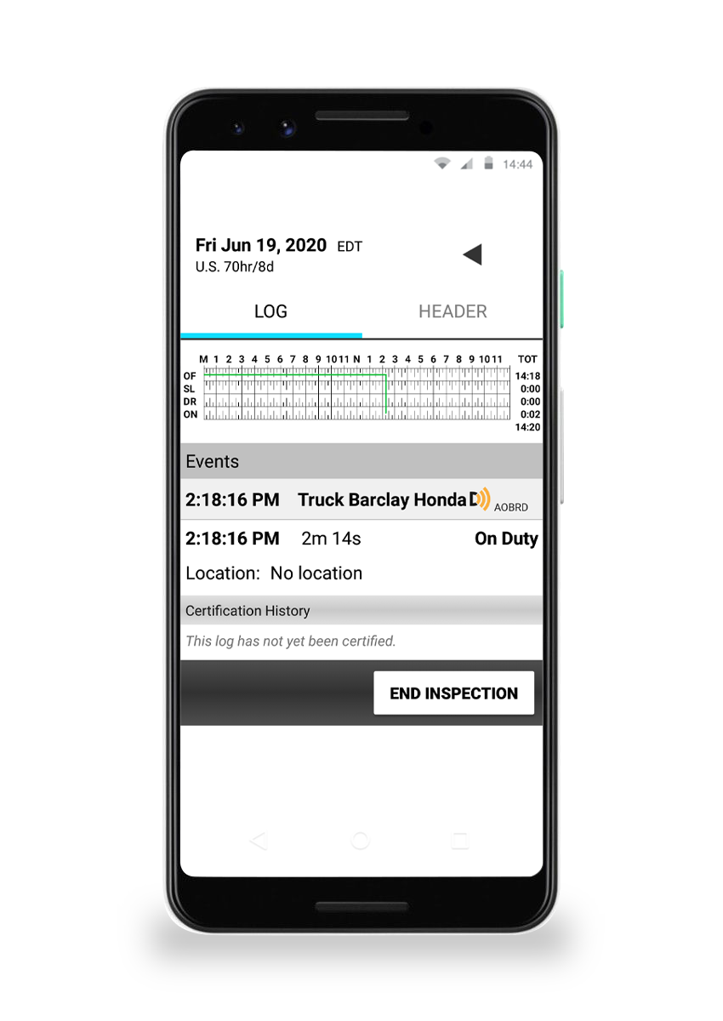
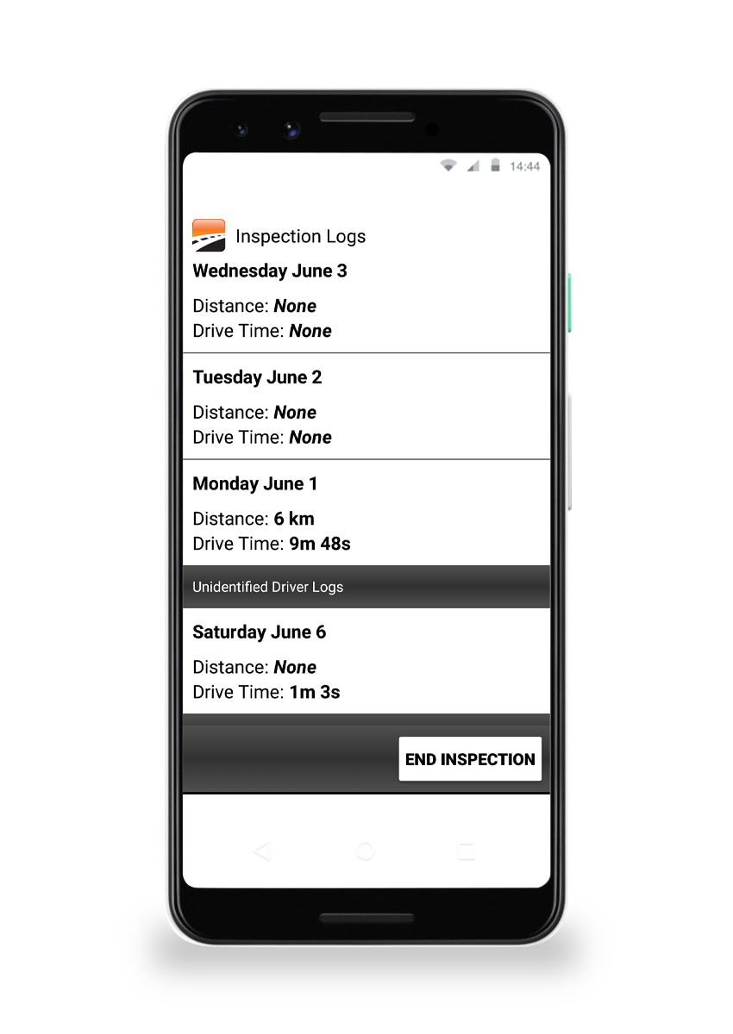
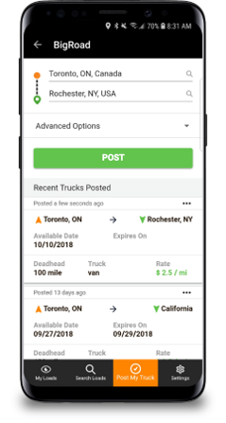
ELD Compliance
BigRoad's ELD solution is the most affordable user-friendly way to create compliant, engine-connected logs. Designed with drivers in mind, the mobile app is user-friendly and automatically counts down hours of service (HOS), records duty status, and displays traffic conditions.
Driver duty status, vehicle drive time, and driver availability are automatically recorded from the vehicle's ECM, creating accurate logs and reports. Pass the DOT audits seamlessly and protect your CSA scores.
Our ELD solutions include BigRoad Freight, a smart load board that makes it easy to source, negotiate, and haul loads so you can keep your trucks full and on the road.

Slide 13
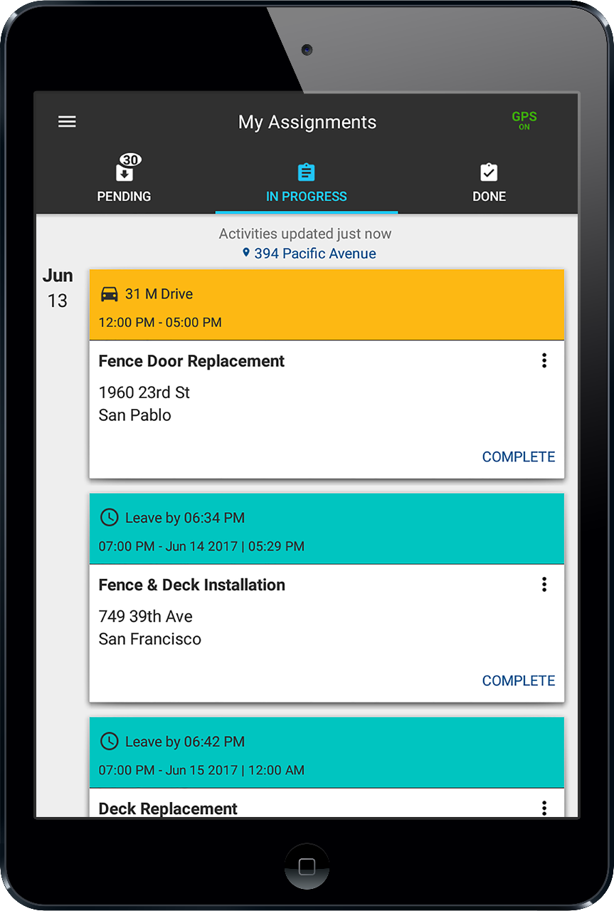
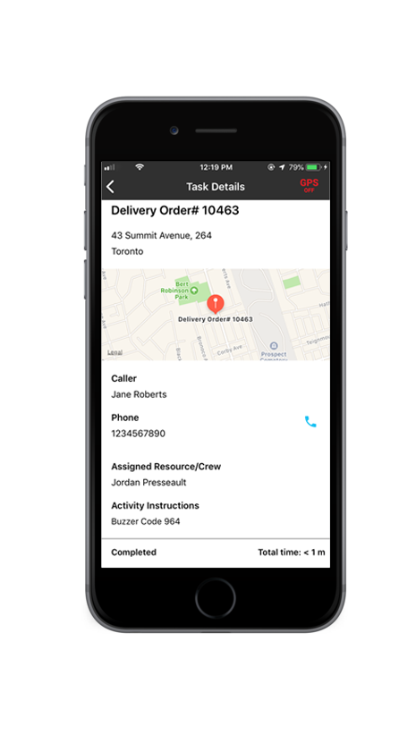
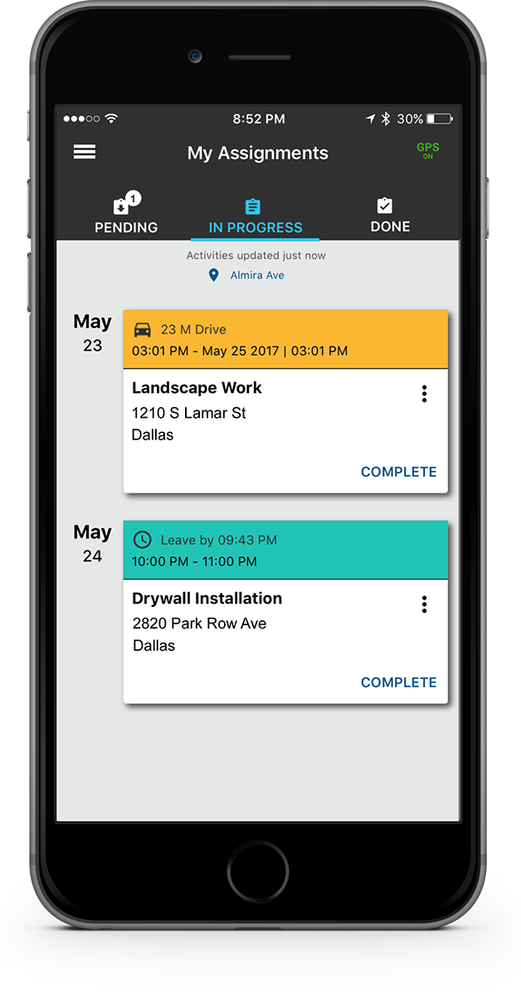
Task Tracker
Task Tracker is a cost-effective mobile workforce tracking and dispatching solution. With Fleet Complete's task tracker, dispatchers can send activities to mobile workers based on their geographical position, availability and workload.
Complete crew visibility: locate every crew member on a map and see their availability in real-time
GPS location time stamp: know where and when a mobile worker has updated an activity status
Activity time tracking: track how long it takes to complete an assignment or a job for better allocation in the future
Timecard: keep your dispatcher informed on worker availability by allowing your crew to clock in, start break and clock out

Slide 14
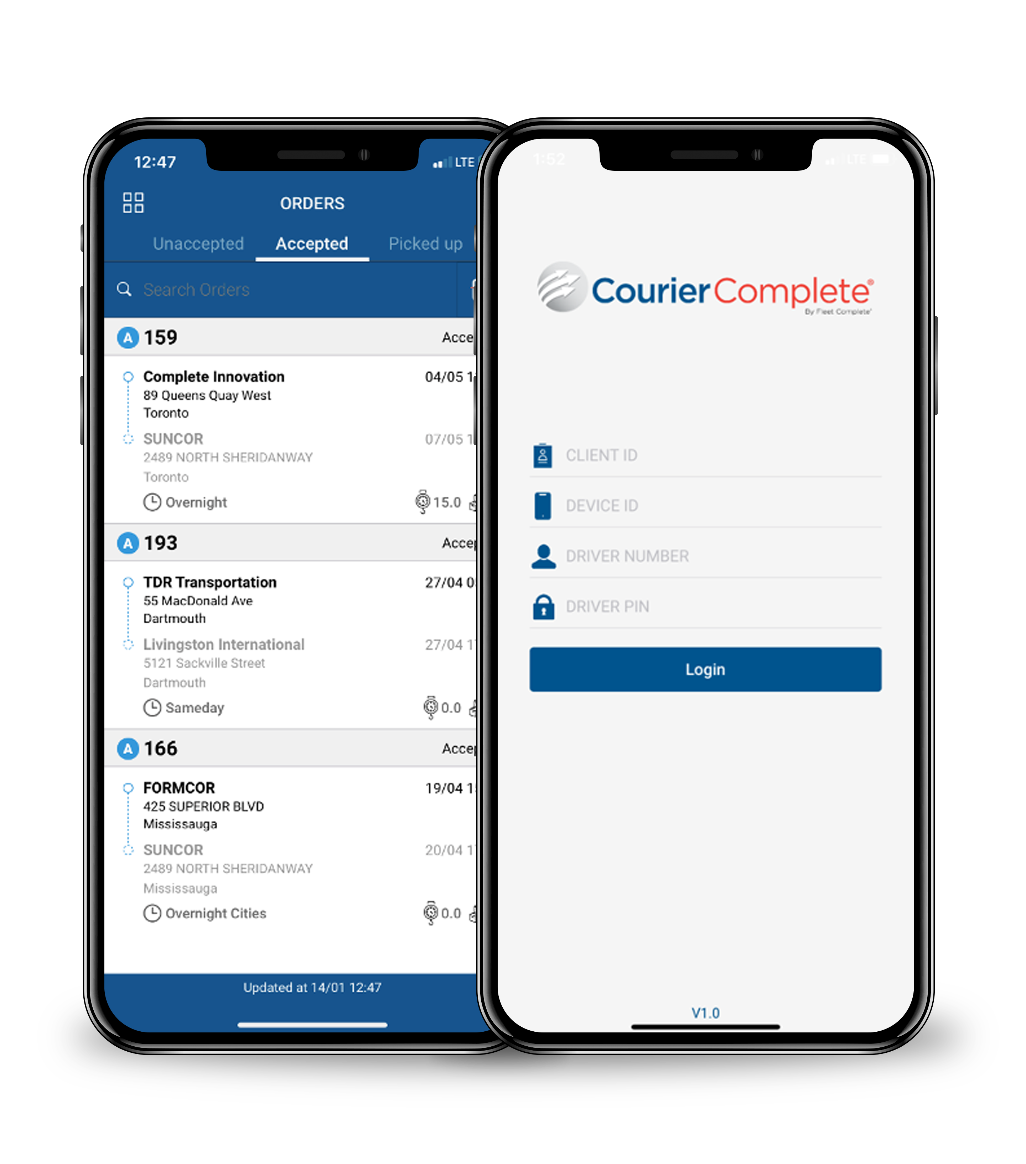
Courier Complete
The platform allows you to operate high volumes quickly and efficiently. With automated order processing, multi-leg routing and real-time ETA board, you’ll have optimal management of last-mile logistics and your courier processes in the field.
Next-gen dispatch
Automated order entry
Digital data capture
ETA board
Customer web portal
Billing & invoicing
Integrations
Driver ID
Reports

Slide 15
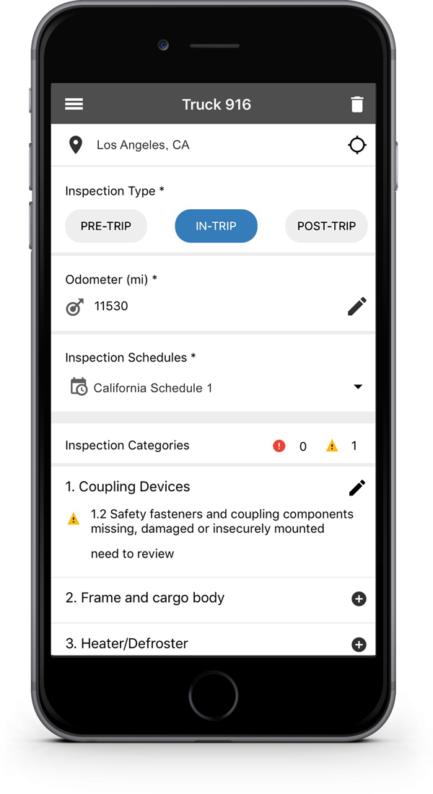
Inspect
Inspect by AT&T Fleet Complete is a mobile application that allows drivers to complete their Driver Vehicle Inspection Reports (DVIR) to stay compliant with government regulation in the U.S. and Canada. Drivers can perform pre/post-trip vehicle inspections, log any minor or major defects, and sign off on the report, providing fleet managers with instant status updates.
Greater efficiency during vehicle inspections
No paper trail
Compliance with government schedules
View of previous and current defects logged
Integration in Mechanic Portal

Slide 16
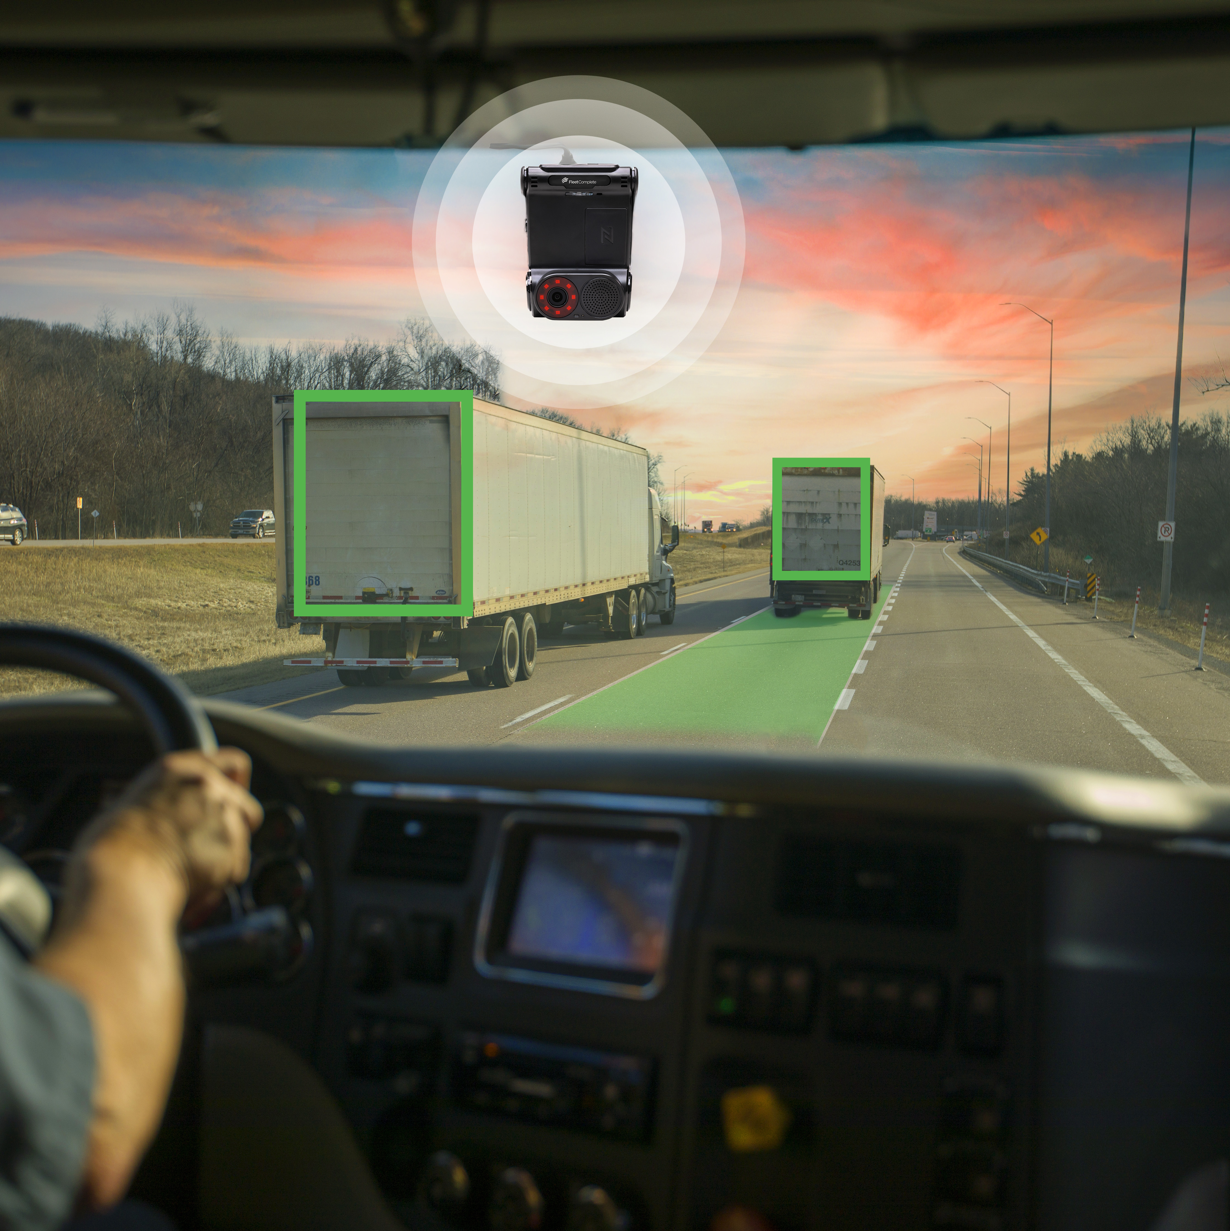
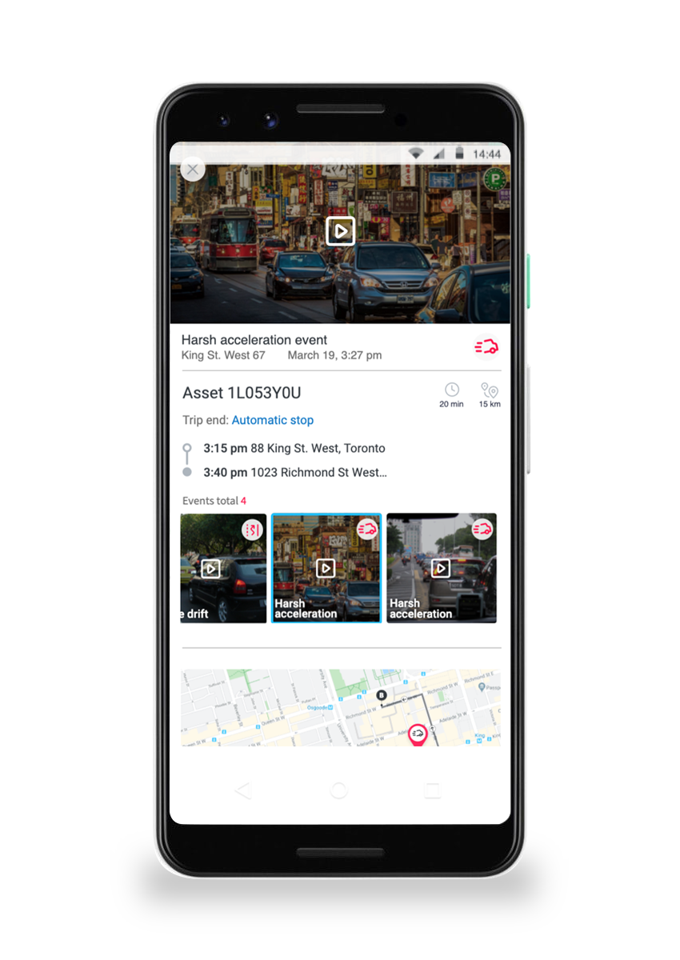
Vision 2.0*
Your optimal fleet safety program with in-cabin and road-facing dash cam provides video event recording, trip analysis, and in-cab driver coaching – without the high price tag. Suited for business fleets of any size, this reliable video event recording solution includes near real-time analytics and in-cab voice assistance to significantly improve your fleet safety and driver coaching.
Equipped with a dual-facing, dash-mounted, WiFi-enabled camera, you will be able to capture events, such as:
Tailgating
Rolling-STOP violations
Posted speed limit violations
Lane drift
Harsh braking
Harsh acceleration and cornering
*Vision is compatible with Android devices only.

Slide 17
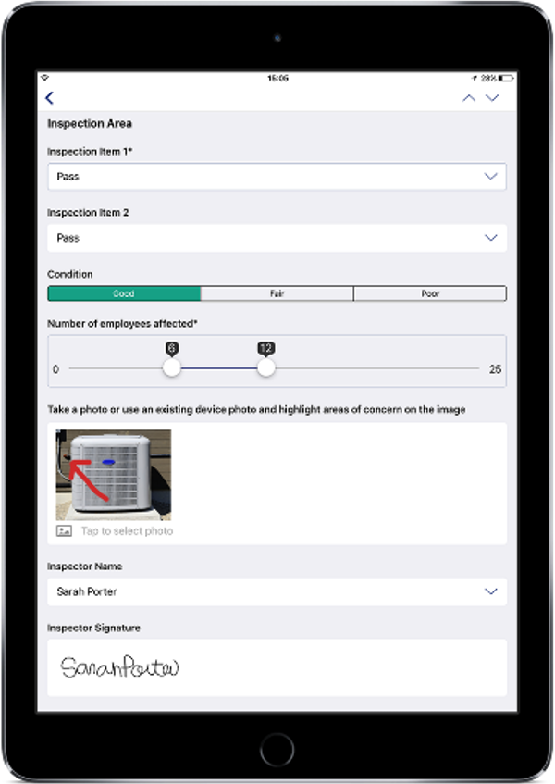
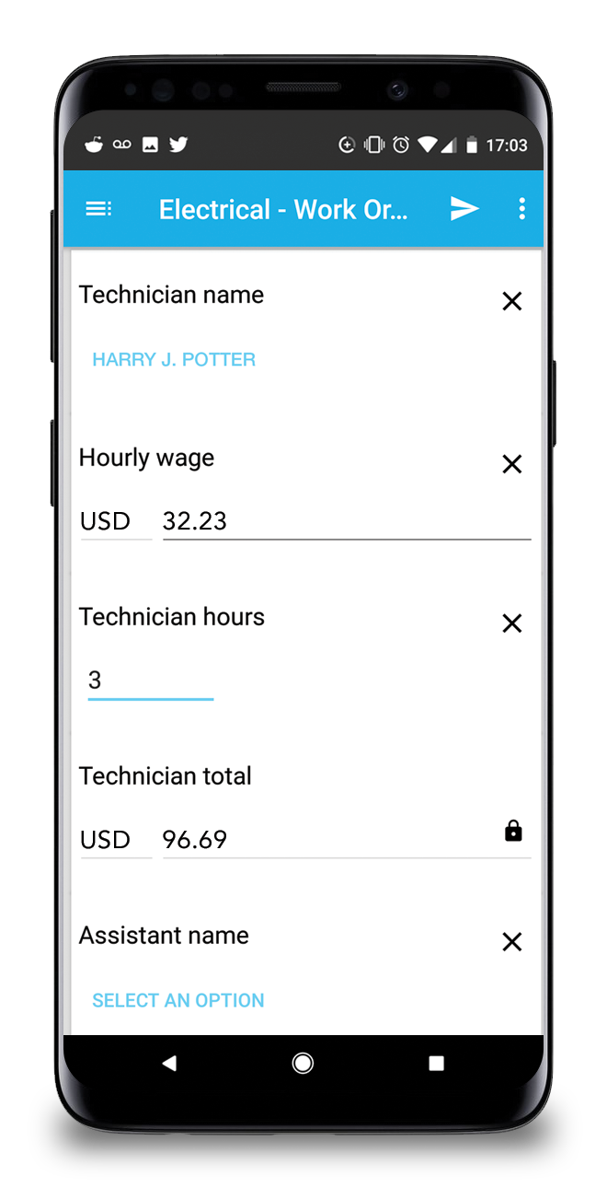
Forms
Eliminate endless paperwork and multiple trips to the office and back, saving you and your mobile workers time on copious administration.
Use the mobile app to submit work orders to your field resources seamlessly
Collect signatures and scan barcodes with a mobile device, increasing your workflow efficiency
Build customized digital forms to your immediate needs to quickly adapt to different tasks at hand
Include calculations and media, like pictures and sketches, to provide better insights into inspections or client issues on the spot

Slide 18
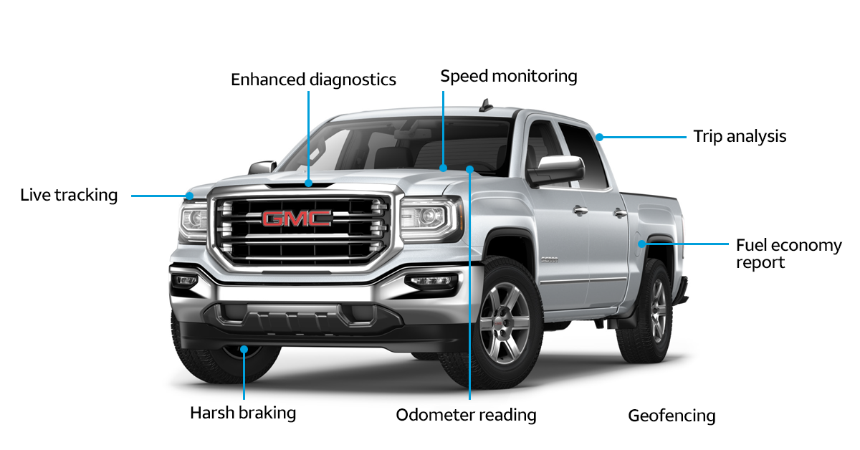
OEM - GM
General Motors Integration
No hardware cost or installation
Instant access to AT&T Fleet Complete platform
Cost efficient
Use Cases:
Mixed fleet
GM fleets
*Most GM vehicles Model Year 2015 or newer vehicles, equipped with compatible OnStar hardware.

Slide 19
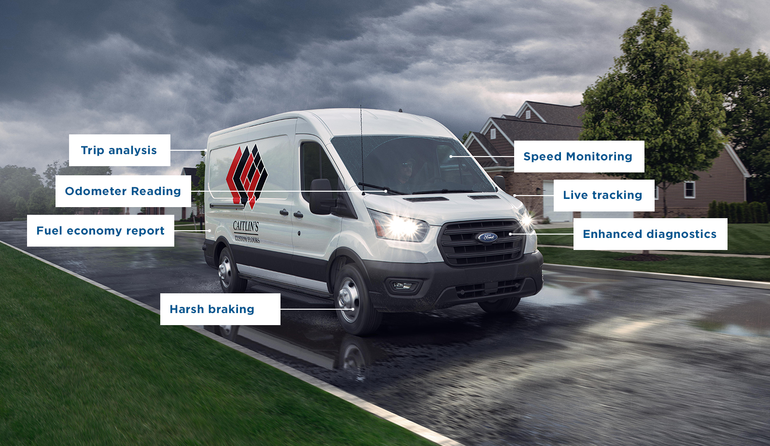
OEM - Ford
Ford Integration
No hardware cost or installation
Instant access to AT&T Fleet Complete platform
Cost efficient
Use Cases:
Mixed fleet
Ford fleets
*Most Ford vehicles Model Year 2020 or newer vehicles.

Slide 20
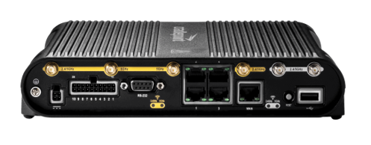
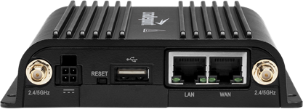
Cradlepoint
Band-14 certified integrated telematics and networking solution powered by Fleet Complete and Cradlepoint.
Fleet Complete and Cradlepoint’s integrated fleet solution provides police, ambulance and rescue fleets unparalleled wireless connectivity on the FirstNet Band 14 dedicated network; continuous visibility into the status of vehicles and teams in the field; and accurate location, status and action reporting.
Cradlepoint’s cloud-managed, all-in-one LTE/5G in-vehicle solutions satisfy a wide range of today’s fleet connectivity and networking needs, including:
Data encryption
Enterprise-grade security
VPN capabilities
Ruggedization for extreme situations
Fleet Complete software subscription + Router = 1 Gross Add*
Cradlepoint IBR1700 ​
IBR1700 is LTE 5G Ready with W-series adapter​
Fleet Complete software subscription + Router = 1 Gross Add*
Cradlepoint IBR900​ in-vehicle LTE router
*The Cradlepoint router and Fleet Complete software must be purchased at the same time to count as a gross add.

Slide 21
Partner Hub
Our Partnerships and solution integrations will help you do even more with your AT&T Fleet Complete solutions.

Slide 22
AT&T Fleet Complete Use Cases

Slide 23
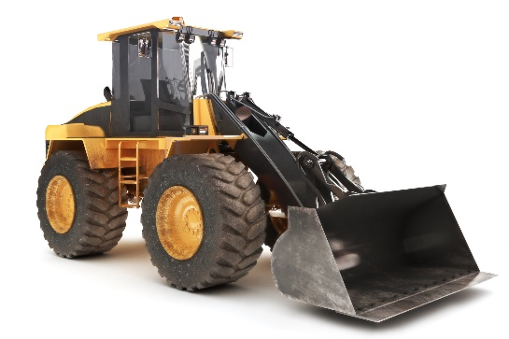
Use Cases: Fleet Tracking
Heavy Duty Fleets
Light Duty Fleets
Yellow Iron
Supports AT&T Fleet Complete HoS for FMCSA regulation compliance
ECM Integration
DTC Codes and ‘check engine’ reporting
Odometer and VIN validation
Crash detection alert
Track location of trailers
ECM Integration
DTC Codes and ‘check engine’ reporting
Odometer and VIN Validation
Fuel Economy
Crash detection alert
Alerts of arrival or departure from location
Monitor unauthorized movement outside your job site
Track PTO usage for IFTA reporting
Lost or stolen asset recovery

Slide 24
Fleet Tracker Additional Sensors
Power Take-Off Sensor
Satellite Failover
Driver ID Key Fob
Temperature Sensor
Captures accurate times when the auxiliary equipment powered by the vehicle is in use by monitoring the PTO sensor switch status (on/off).
Used for fuel tax reporting
Accurate timesheets for work performed minimizes under-the-table work
Ideal for tow trucks, dump trucks, liftgates, cranes, forklifts
Satellite antenna provides back-up when the vehicle is working in remote areas out of cellular range.
Used by fleets with operations in remote areas
Additional service activation required
ideal for pipeline, environmental and construction services
Allows identification of a driver/technician operating the company vehicle.
Unique programmable Key Fobs
Multiple drivers per one vehicle
Identify who operated the vehicle and their driving behavior
Ideal for company-owned vehicles with contractor driver/operators
Installs inside the refrigerated trailer and logs the temperature of the trailer environment at regular intervals.
Provides proof of temperature during transportation at delivery
Alerts of spikes in temp changes
Up to 4 sensor probes can be installed inside the trailer
ideal for pharma/food transport

Slide 25
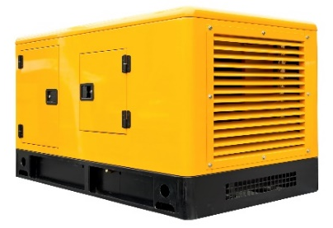
Use Cases: Asset Tracker
Equipment
Trailers & Storage
Generators
Hardwired to power or mag mount
Construction, oil & gas, pipeline
Magnetic mount or attached with screws, with optional door sensor or a container lock
Trucking, logistics, storage
Hardwired, with optional fuel level sensor
Construction, oil & gas, pipeline, landscaping

Slide 26
Use Cases: Task Tracker
Service Industry
Construction Sites
Property Management
Tracking of arrival/departure at a location
Simple delivery/pick-up requests
Order status confirmation
Dispatch of simple tasks
Receive simple tasks and activities on handheld
Ability to organize priority of tasks based on due date
Ability to accept/reject/complete each task

